Slide 1


Wireless Perception
Ramon Qu, Rosario Scalise

Slide 2
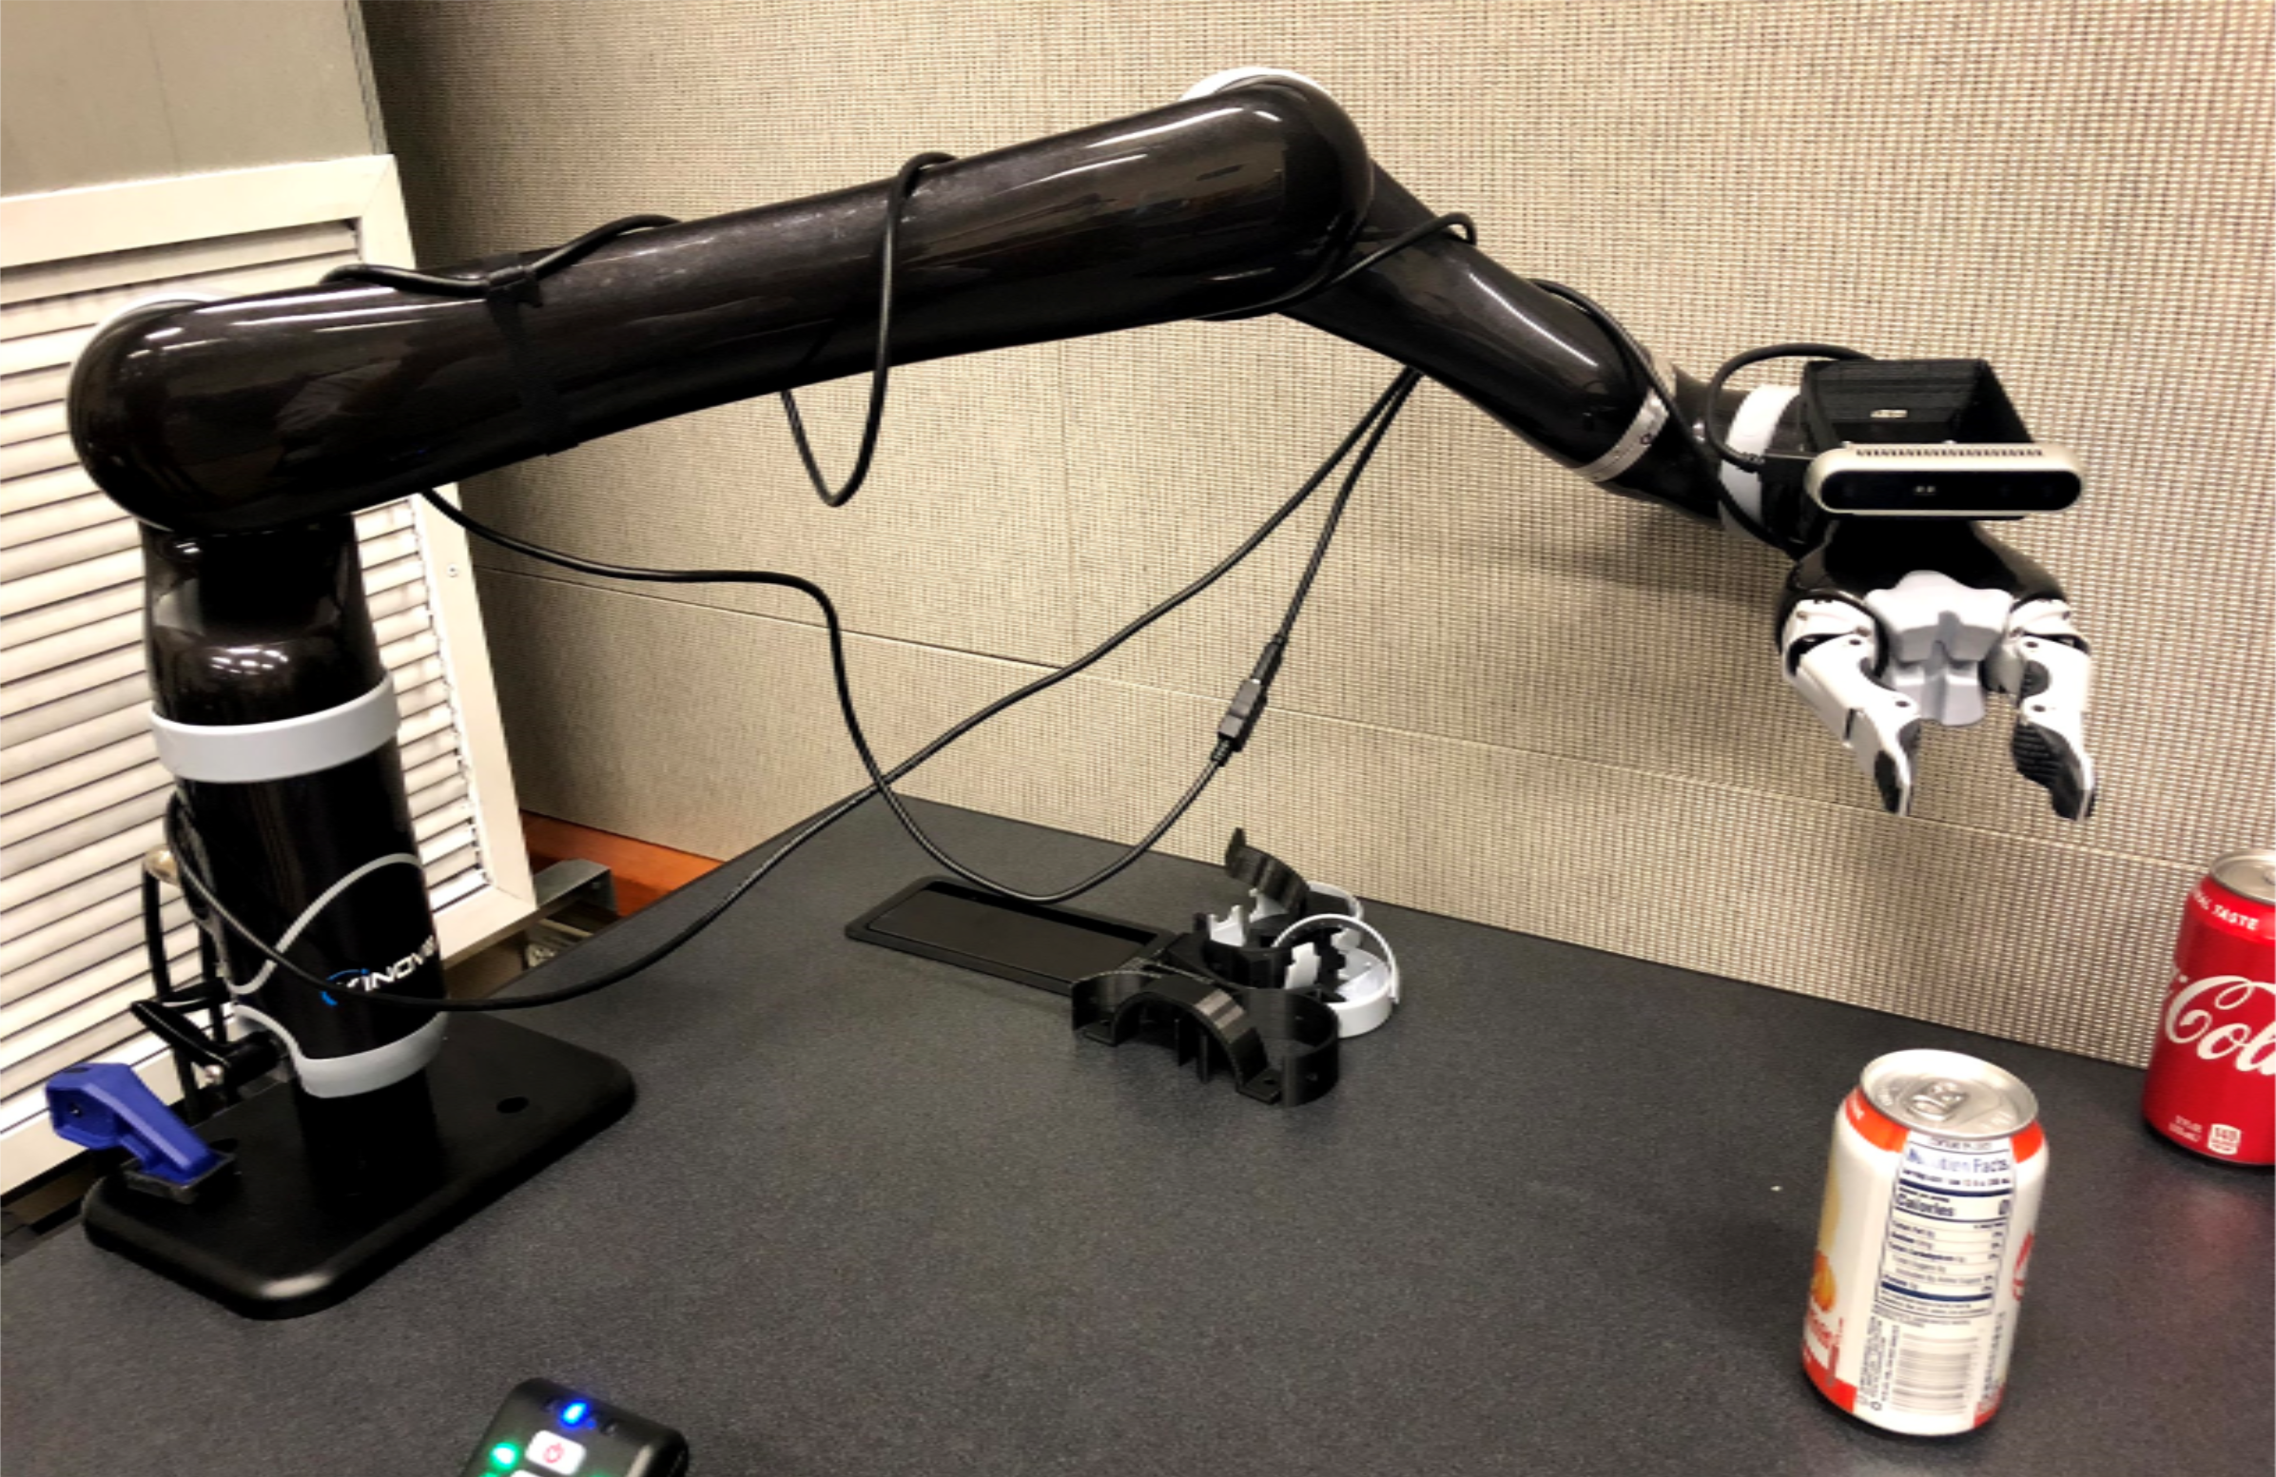
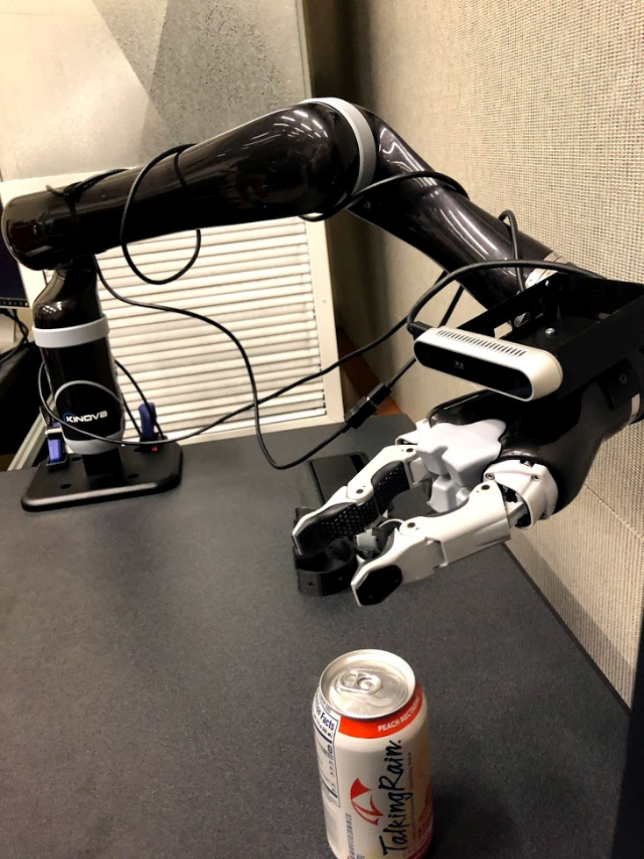
Why Wireless Perception?
Tangling wires when doing movement.
Notes:
Tangling external wires is always a problem of using end-effectors to do some tasks. Like the pictures showing ADA is tangled by the USB cable ehich connects from camera to the host machine. For example, if ADA is trying to feed the noodles for the users. The last joint has to rotate 360 degrees many times which would may break the USB cables.

Slide 3
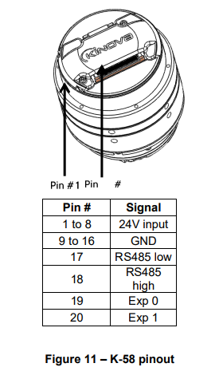
Why Wireless Perception?
Notes:
In ADA, the internal design does not have pass throughs for cables. The only pins we are able to use are the 4 pins showing, which cannot supply enought bandwidth -> video high volume.
Crosstalk with power pins.
Signal degradation through the long body,
Those interference the data continuity.

Slide 4
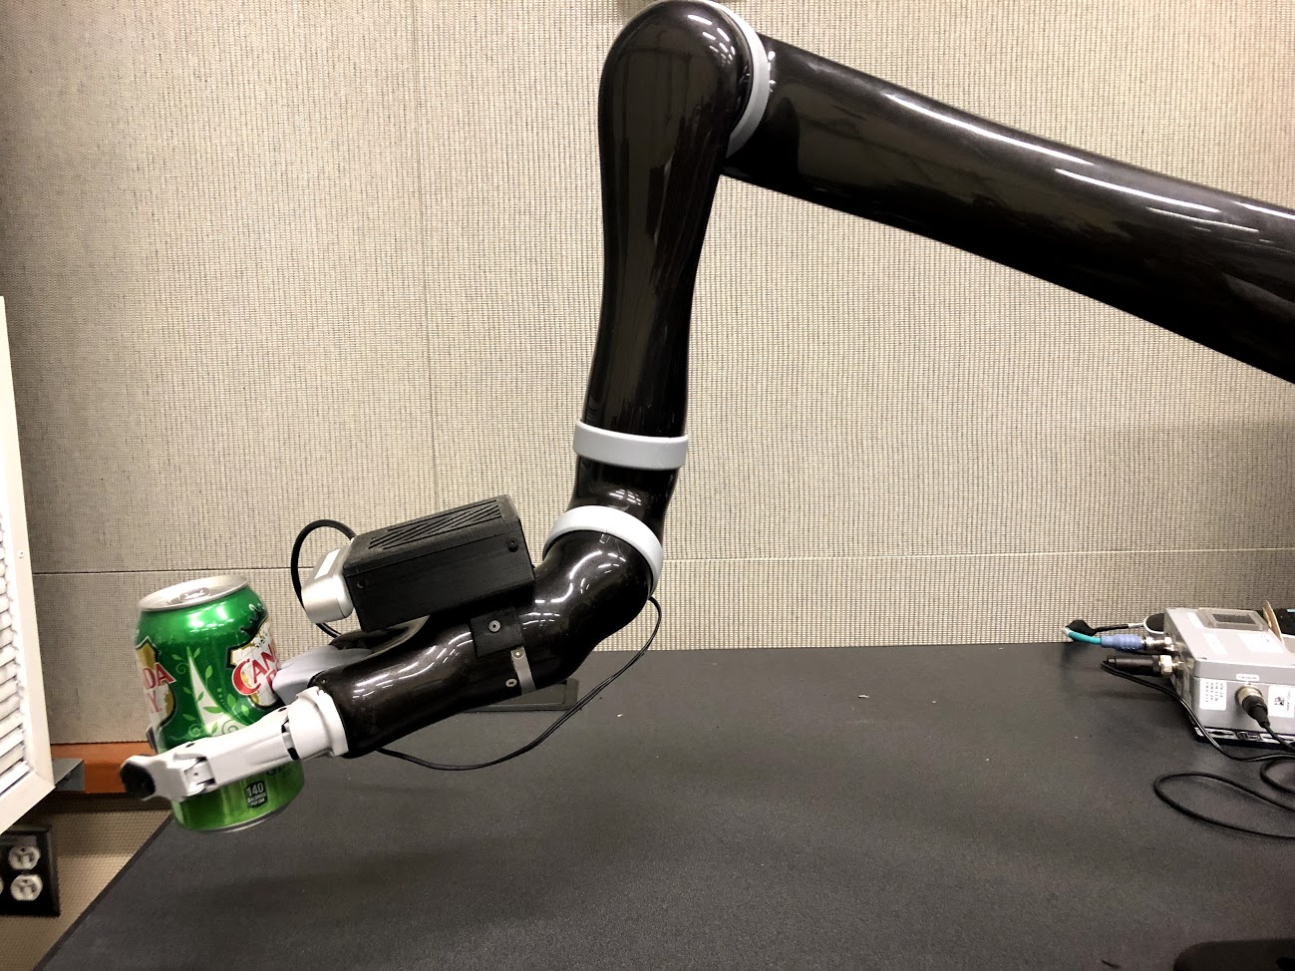
Why Wireless Perception?
Enable POV Perception
Visual-servoing control
Co-deploying with the Robot together. No need to install extra external camera
Notes:
If we have wireless perception, some useful applications would be
First we can have visual servoing control robot, which allows doing tasks based on the live active video feedback.
Secondly, we dont need to install extra external camera for the end-effector. For example, , mounting the robot on a wheelchair will give us perception for free as well - we won’t have to integrate some kind of external camera somewhere else) When delpoying the robot, it will also co-deploying the camera.

Slide 5
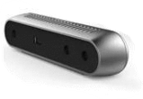
Application requirements.
Sensor Choice :
3 important metrics:
Frequency Requirements : At least 15 FPS @ 640X480 Resolution
Latency Requirements : As low as possible. The best would be <50 ms
Image Degradation Requirements : Lossless on Depth and low data loss on Color.
Intel RealSense R415
RGB: 1920X1080 @30
Depth: 1280X720 @90
Application Requirements
Notes:
For the camera, we used StructureIO and Astra RGBD, but later on we expect to use intel realsense in the lab, so we land on this structural camera. The other two actually are able to use openni2 library as the driver. Intel Realsense has its own driver support.
15 FPS seems enough to feed perception models to complete the tasks.

Slide 6
Design requirements.
Computing Design Requirements : Wifi, Computing Power, Storage, Thermal
Electrical Design Requirements : Ability to efficiently power the board
Mechanical Mounting Design Requirements : Securely mount the board and sensors, Allows the camera to observe the object
Software Design Requirements : Efficiently transmit video feeds with high FPS, low latency
Design Requirements

Slide 7
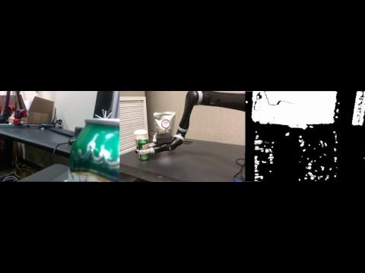
Notes:
Here’s what we built.

Slide 8
Computing Design :
The substrate for handling the task.
Electrical Design :
How to power the substrate.
Mechanical Mounting Design :
How to physically secure the substrate.
Software Design :
The magic incantations to make the task happen.
Design Outline

Slide 9
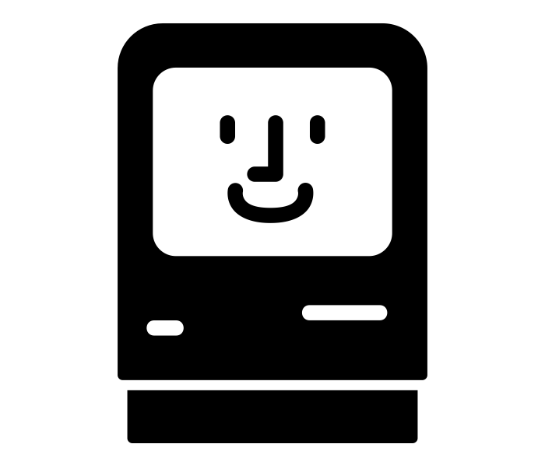
Computing Design
The substrate for the task.

Slide 10
Computing Design Requirements
The embedded board requires:
Wi-Fi Compatibility
Enough Computing Power
Able to install RealSense Driver, Partial ROS (> 16GB)
Computing Design : : Requirements

Slide 11
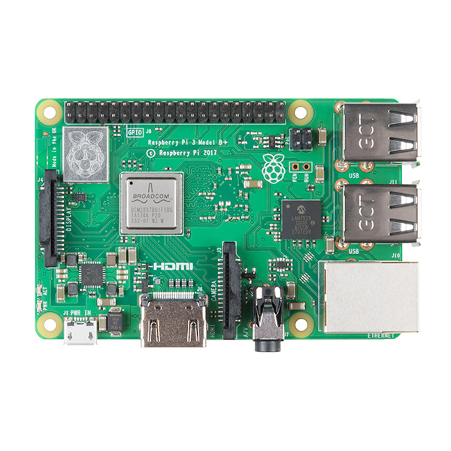
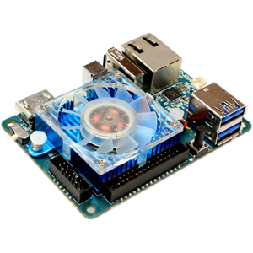
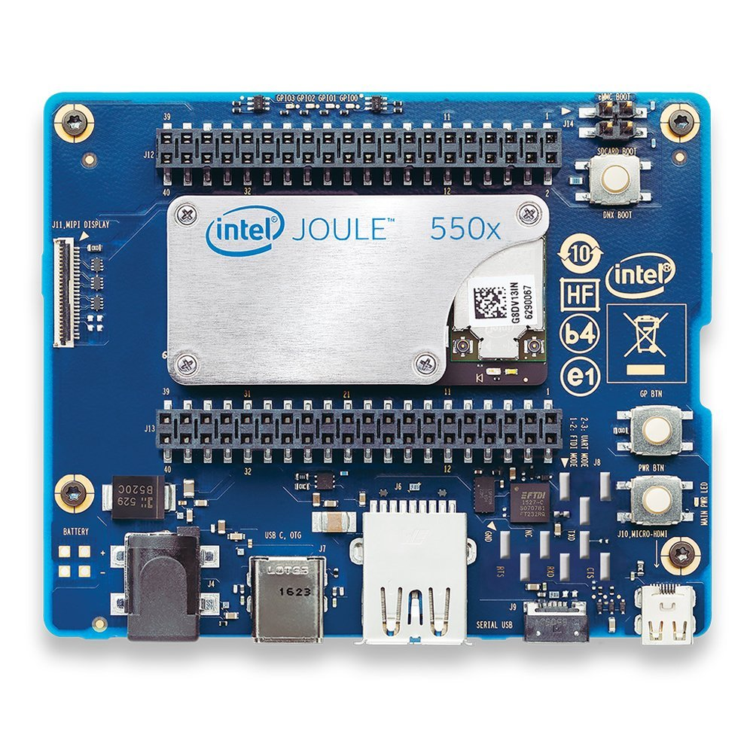
ODroid
Raspberry Pi 3 B+
Intel Joule
Computing Design : : Hardware
Notes:
Odroid, Joule, Raspberry PI,
Maybe mention NVidia Jetson (physical size is too large - verify this).
Physical size: eliminate a lot of other embedded boards
Network -> Intel Joule has the best wifi module, which also support wifi
Computing Power, Intel joule is also the best among those three.
Raspeberry pi only have usb 2.0, but the intel realsense needs usb 3.0

Slide 12

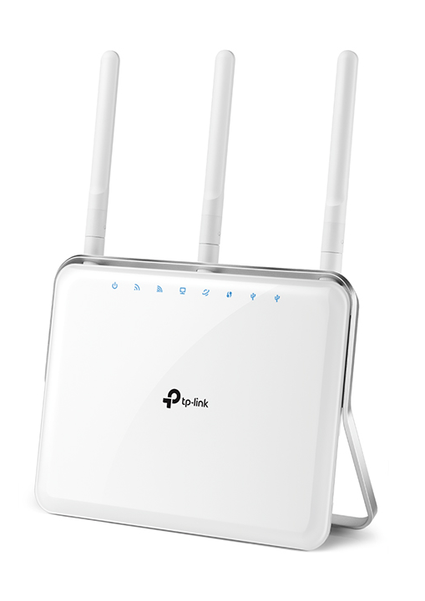
Intel Joule Wifi :
802.11 a/b/g/n/ac support
WPA and WPA2, 802.1x
Support Dual band (2.4 & 5 GHz)
Wi-Fi Direct
TP-Link:
Supports 802.11ac
Simultaneous 2.4GHz 600Mbps and 5GHz 1300Mbps
3 dual band detachable antennas provide maximum omni-directional wireless coverage and reliability
480P Raw Video
221.18400 Mbps
Computing Design : : Networking Hardware
Notes:
The max speed of 802.11 ac, 2.4Gh would support the longer distance wireless transmission, and 5Ghz would support the short distance and high transmission rate.

Slide 13


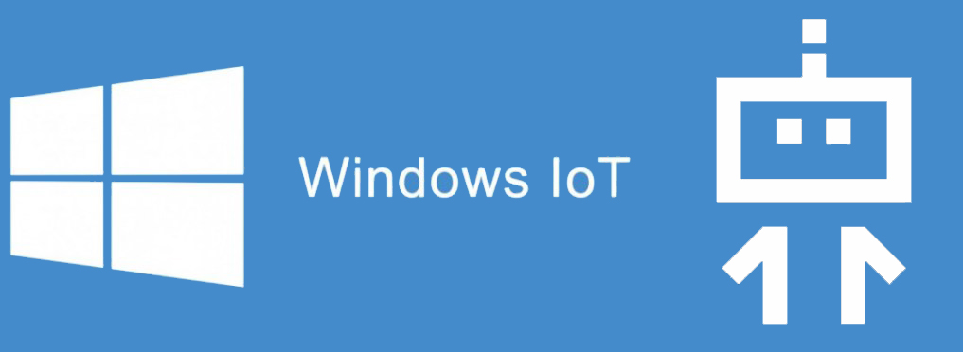
VS.
Computing Design : : Operating System
Notes:
Discuss your OS choice. Briefly argue for running full OS over embedded microcontroller or ASIC because of software flexibility. (for extensibility, mostly)
Ubuntu Core, Windows IoT -> Application based operation system, which you are only able to deploy applications but dont have access to lower layer of the system, like controlling the camera drivers.
Windows IoT only supports C# Universal Platform Applications.

Slide 14


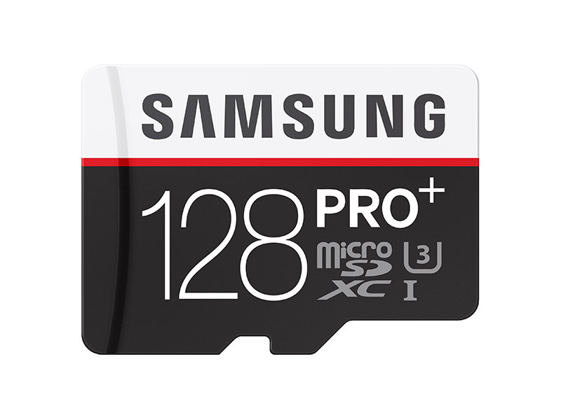
+
+
16 GB Embedded Storage
+
Computing Design : : Memory
Notes:
Before with the embedded storage, after install lite version Ubuntu, I can barely fit the base version of ROS on the disk. But when I try to stream the video, there would be a lot of the memory and temperary space got occupied. So the disk storage is actually not enough to stream the video long enough. And you have to clean the disk space once while.
Then I install the OS on the micro SD card and let the board boot from the Micro SD card to solve this issue. This time I am able to install the whole ROS on it and enough space for caches.
So that, I will talk more in the software design, I actually designed two methods one is for the embedded system which having ROS on board, and another one without using ROS.

Slide 15
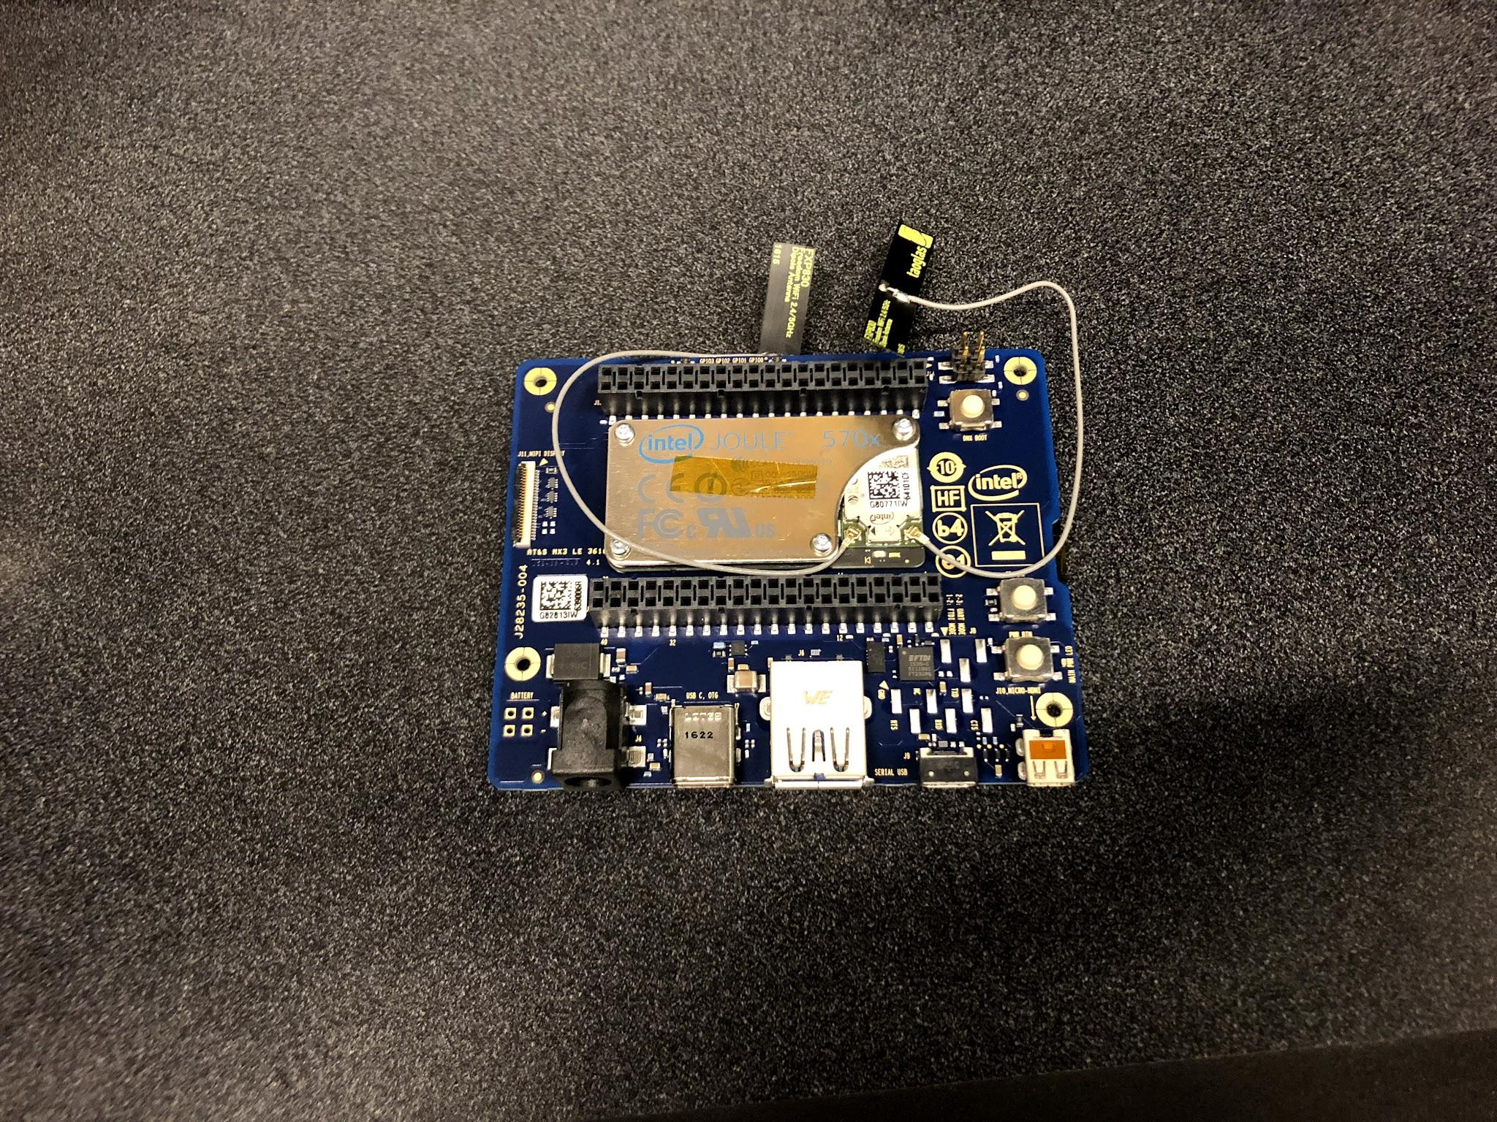
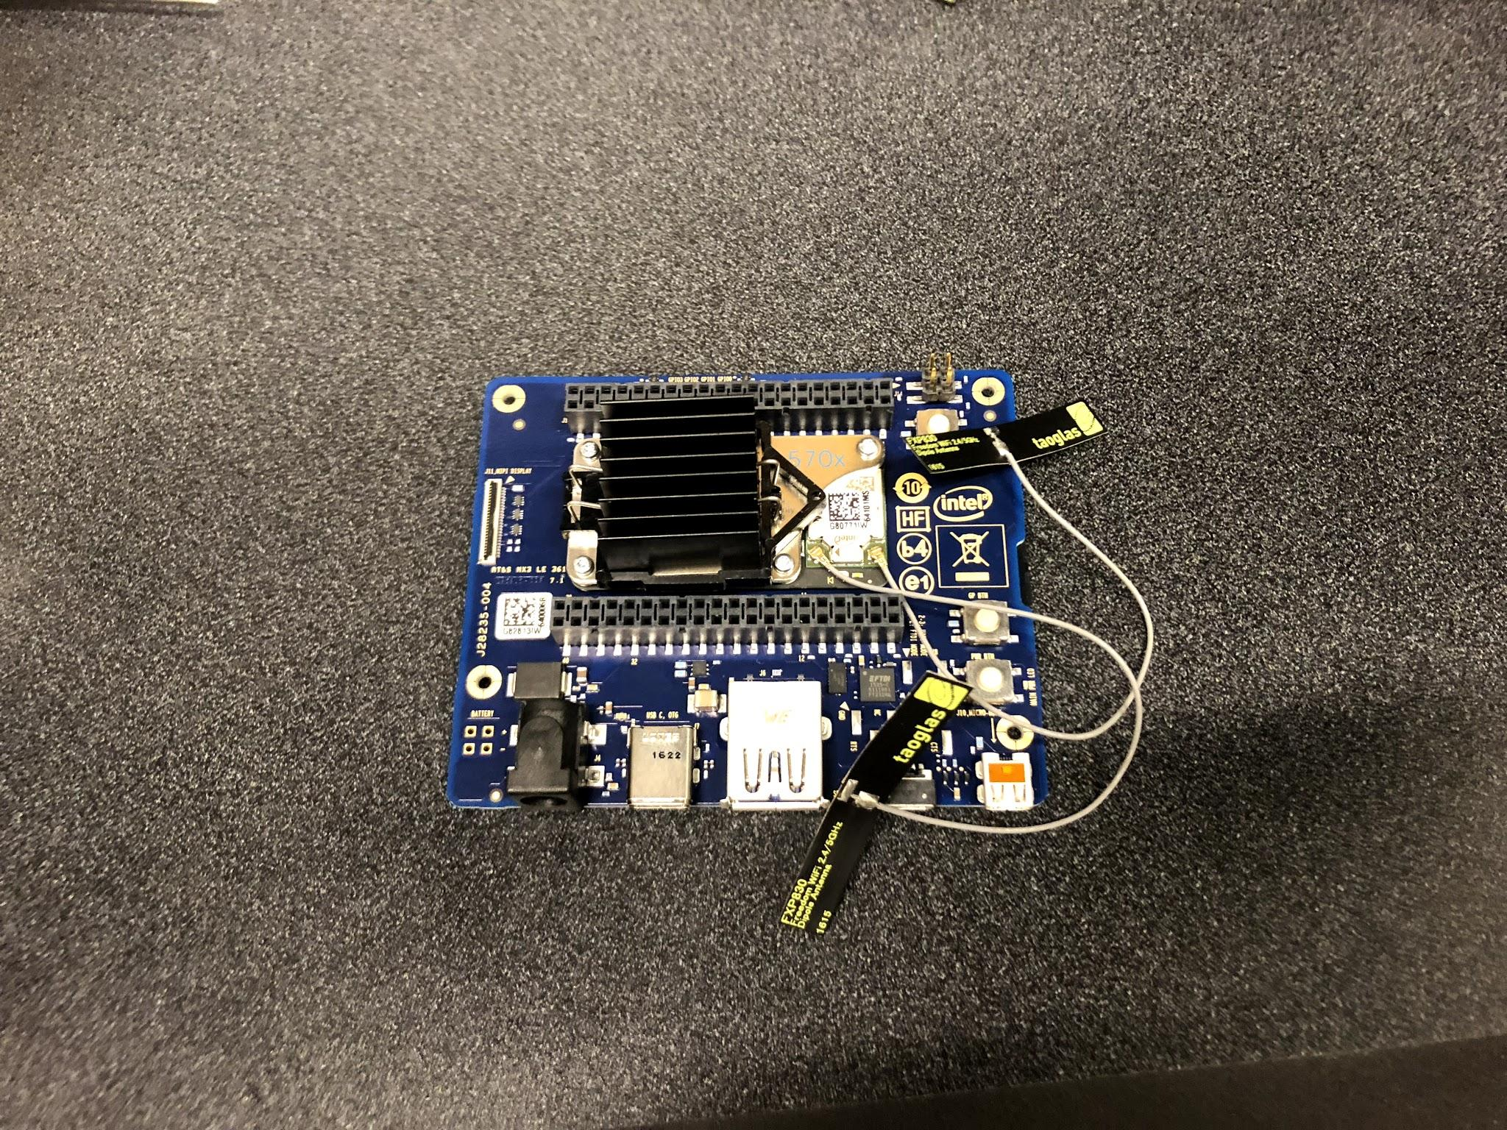
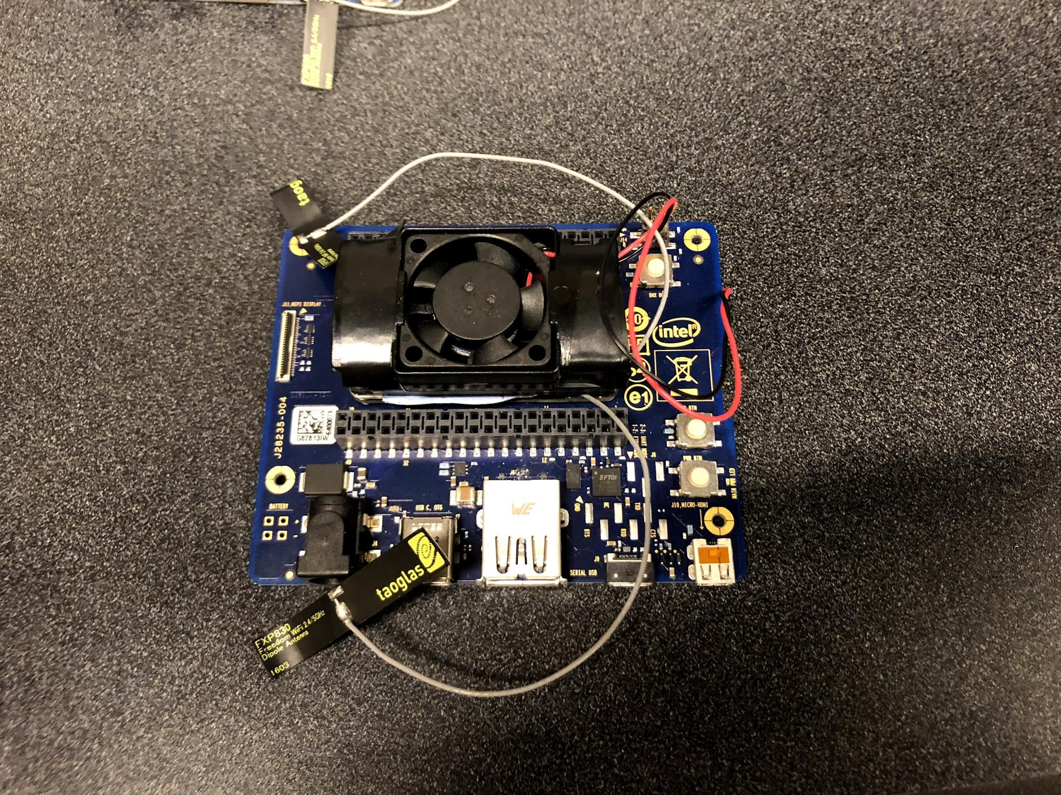
No Cooling
< 30 min
Passive Cooling
~ 30 min
Active Cooling
> 2hr ?Max
Computing Design : : Thermal
Notes:
One of the challenge when streaming the board was the thermal radiation. The board would heat up especially when streaming the video. Ubuntu system actually shut down when it get to hot. It actually happened when there is no cooling. Even with passive Cooling, it would also reach the max temp around 30 minutes.
So we investigate and bough this active cooling fan right fit on the cpu module. I haven’t test the longest time it can keep streaming, but during my previous tests, which is definitely over 2 hours and it is running no issues.

Slide 16
Trade-Offs
High power consumption vs Computing Power
Thermal radiation vs Computing Power
Computing Design : : Trade-offs
Notes:
Computing power -> higher power consumption
Computing power -> high thermal radiation

Slide 17
Electrical Design
Delivering power to the substrate.

Slide 18
Electrical (power delivery) Requirements
Joule + Sensor need minimum power 1.5A @ 12V
Kinova J6 supplies max 3A @ 24V
Compact circuit design which fit in the hand
Electrical Design : : Requirements
Notes:
E.g. joule+sensor max power req., Limitations imposed by Kinova power source, compact (able to fit in shell of hand or in box)

Slide 19
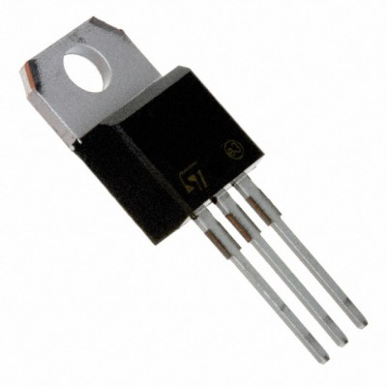
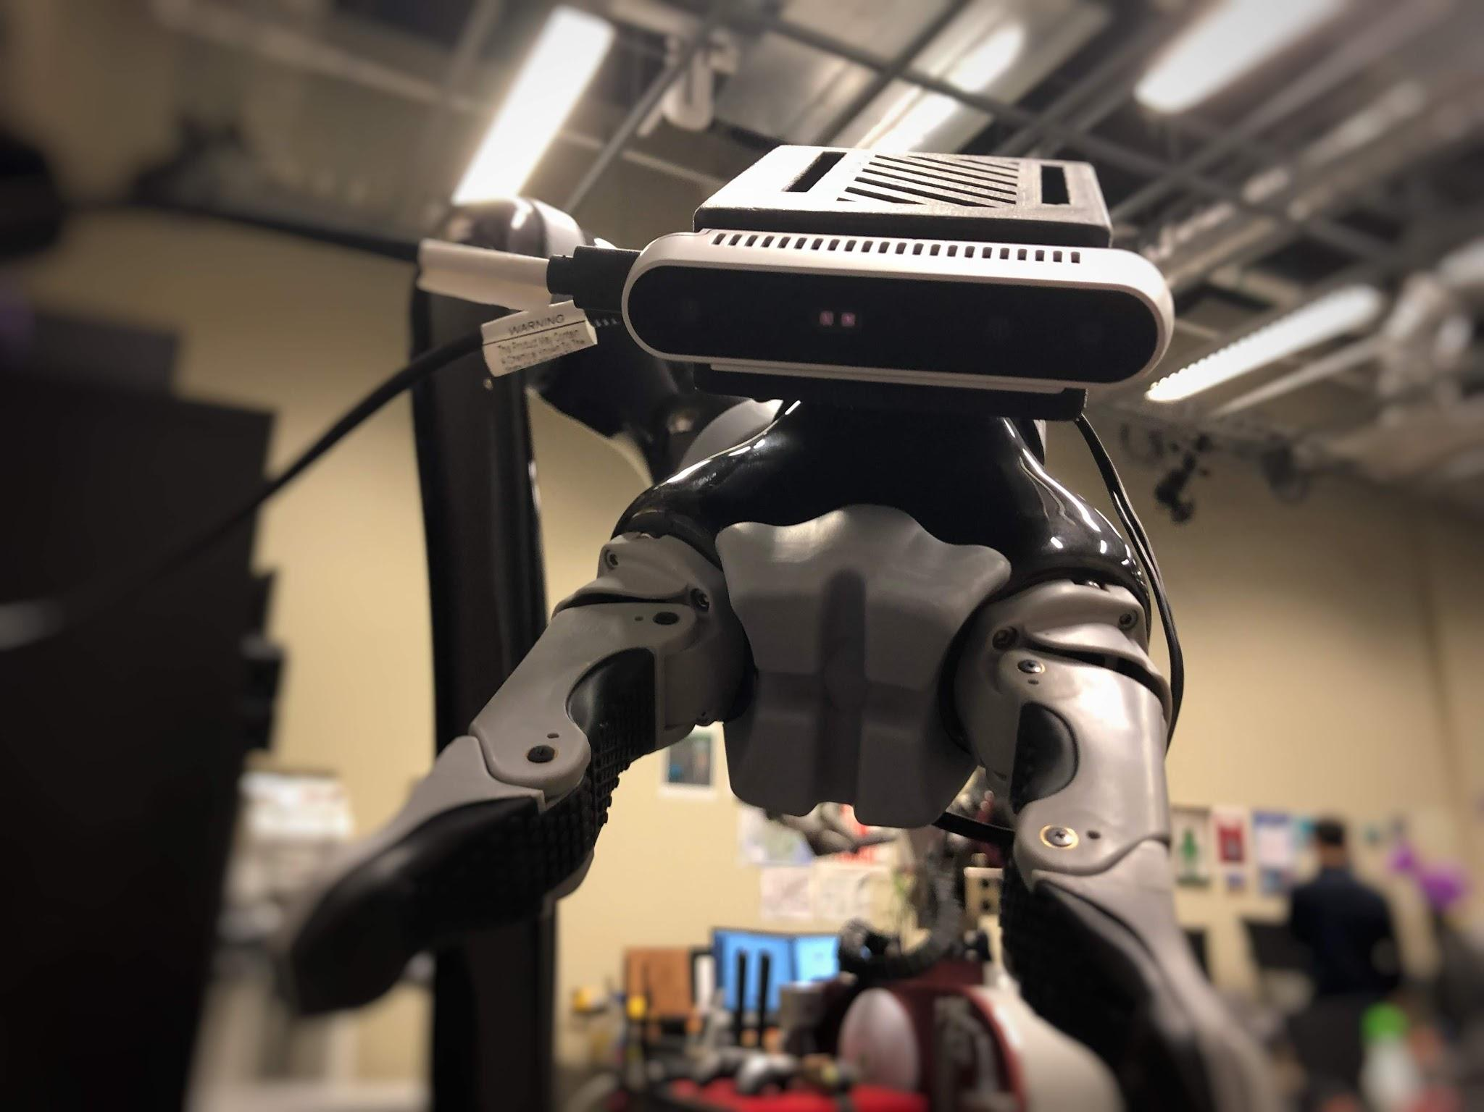
Power Converter
MAX 3A @24V
12V
Electrical Design : : Power Delivery
Notes:
We need some sorts of power converter to convert the step down the voltage.

Slide 20
Gen 1
Booting the OS from embedded storage : Avg 0.6A
Booting from MicroSD: Around 1A
LM340T-12/NOPB-ND
Linear Regulator
Max output current: 1A
Electrical Design : : Power Delivery
Notes:
The first one failed to boot the board.
Show version 1. With first linear regulator.

Slide 21
Gen 2
Conversion Efficiency: ~30%
After launching the camera and streams: ~1.5A @ 12V
KA378R12CTUFS-ND
Linear Regulator
Max output current: 3A
Electrical Design : : Power Delivery
Notes:
Although the second one successfully booted the board, it still failed to launch the camera nodes and stream the videos.
Efficiency

Slide 22
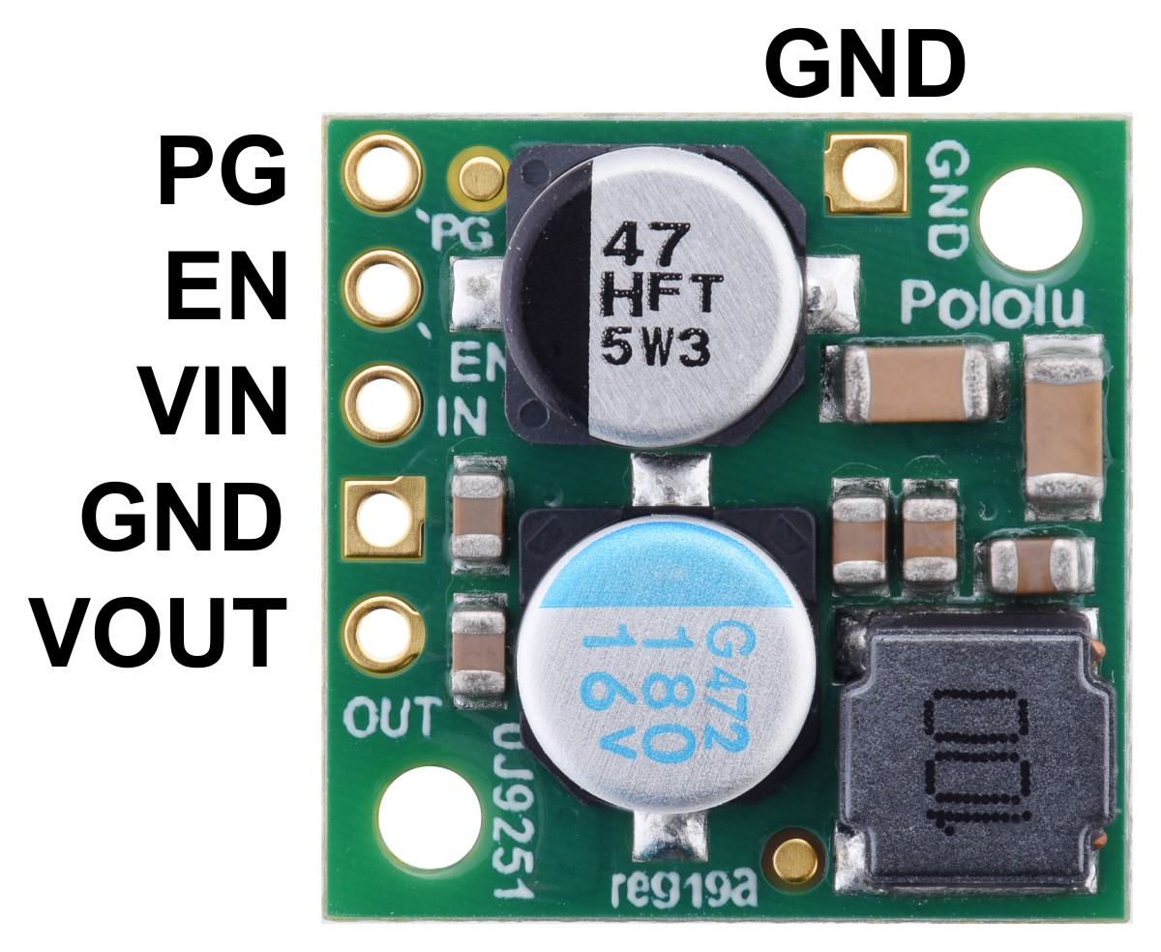
Gen 3
Conversion Efficiency: ~90%
MAX 3A @24V
1.5A @ 12V
Pololu 12V, 2.2A Step-Down
Voltage Regulator D24V22F12
Electrical Design : : Power Delivery

Slide 23
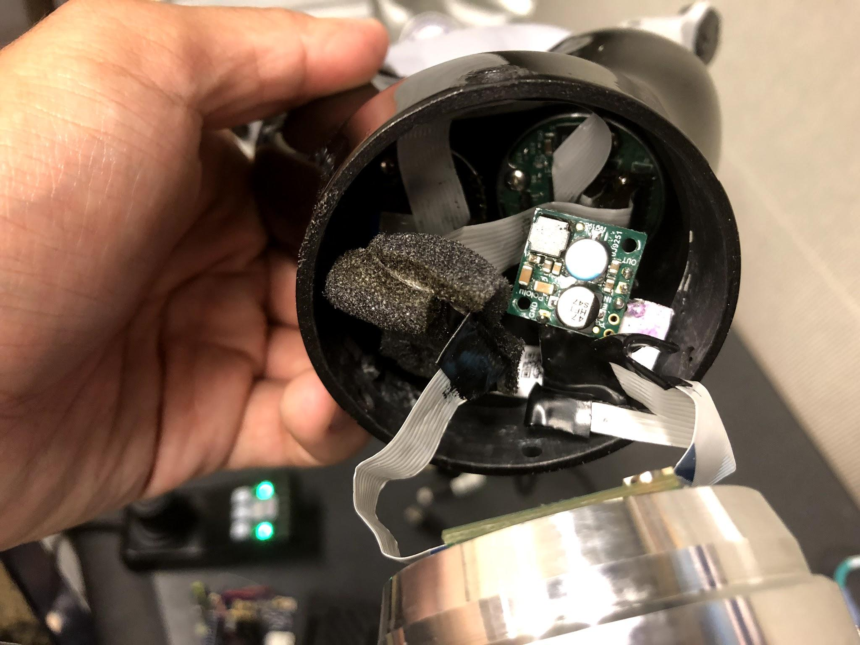
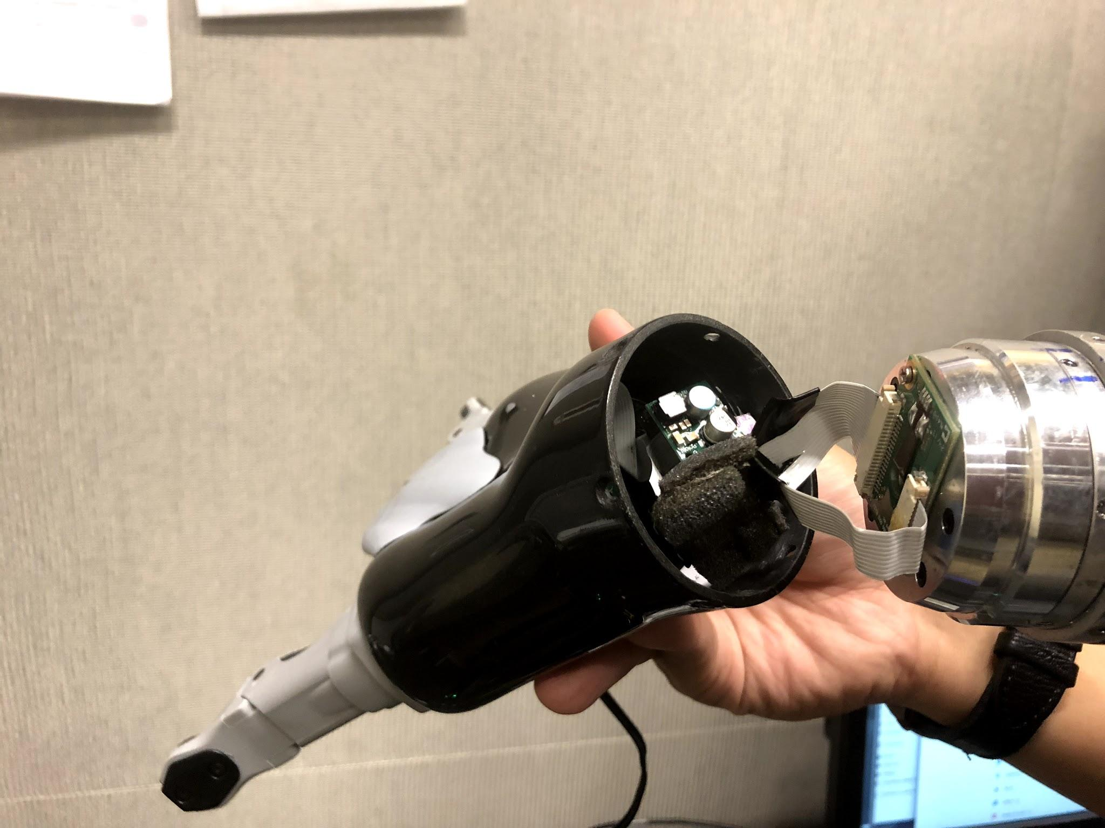
Electrical Design : : Power Delivery
Notes:
Show version 3 (final) with buck converter.
State what you learned! (simple explanation of how these two methods differ)
Highlight efficiency.
Show image of internals (inside shell) and how we got the wire routed.

Slide 24
Trade-offs.
Passive/Active converter vs. size and heat.
Efficiency matters since this is sharing the load with the robot (3A max).
Electrical Design : : Trade-offs
Kinova:
Notes:
Passive converter -> waster power by converting the power to head
Active converter -> modulate AC like flickering DC signal. Which may not be compact,so we did not think baout this first.

Slide 25
Mechanical Design
Physically orienting and securing the substrate.

Slide 26
Mechanical Mounting Design Requirements
Small and able to securely mount on the wrist (J6) of the end-effector.
Respects robots kinematics (no self-collision)
Gives vantage point we need for both the fork and for the fingertips.
15 cm minimum saturation distance for 480P
Mechanical Design : : Requirements

Slide 27
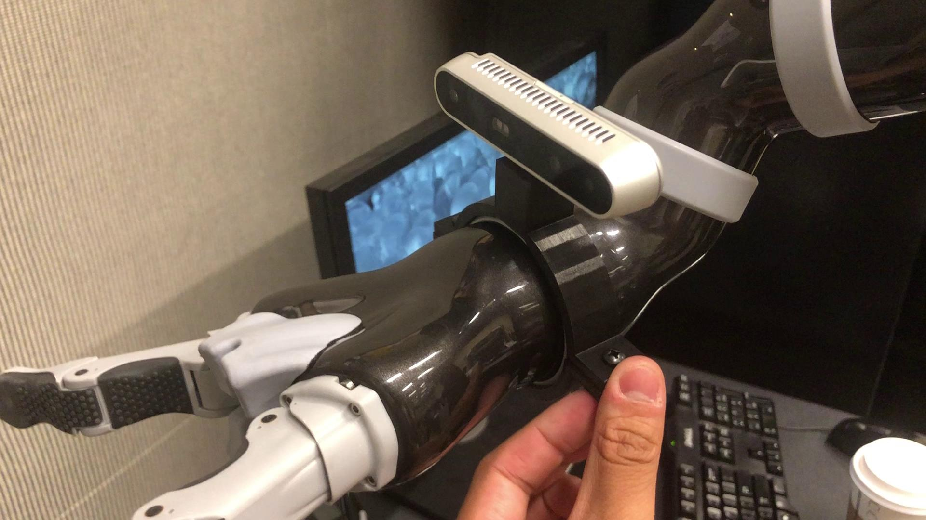
Kinova’s solution to mount the camera
Mechanical Design : : Mounting

Slide 28
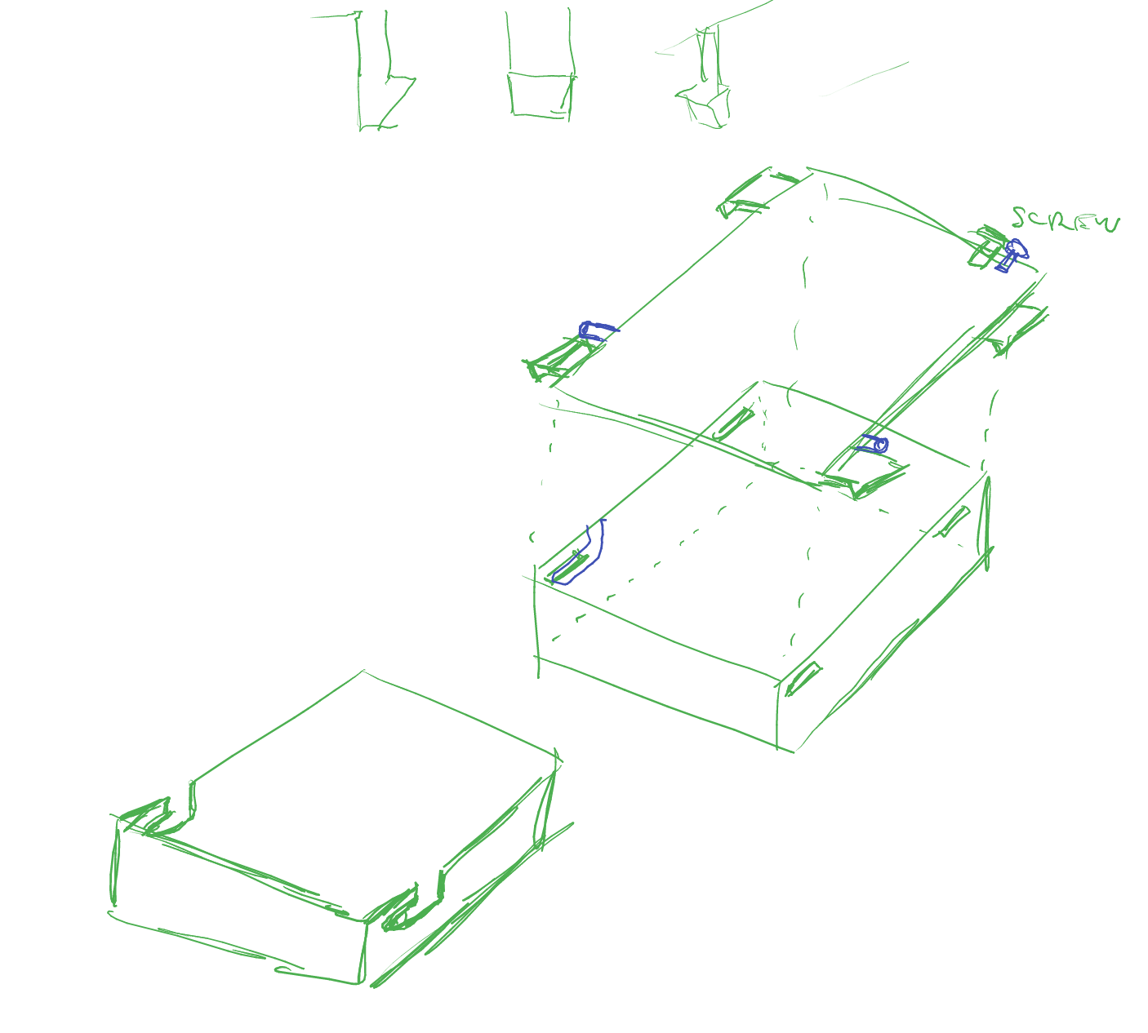
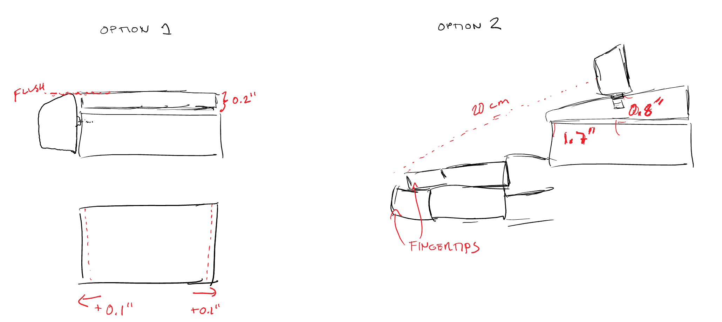
Mechanical Design : : Mounting
Notes:
Sketches of two mounting camera options.

Slide 29
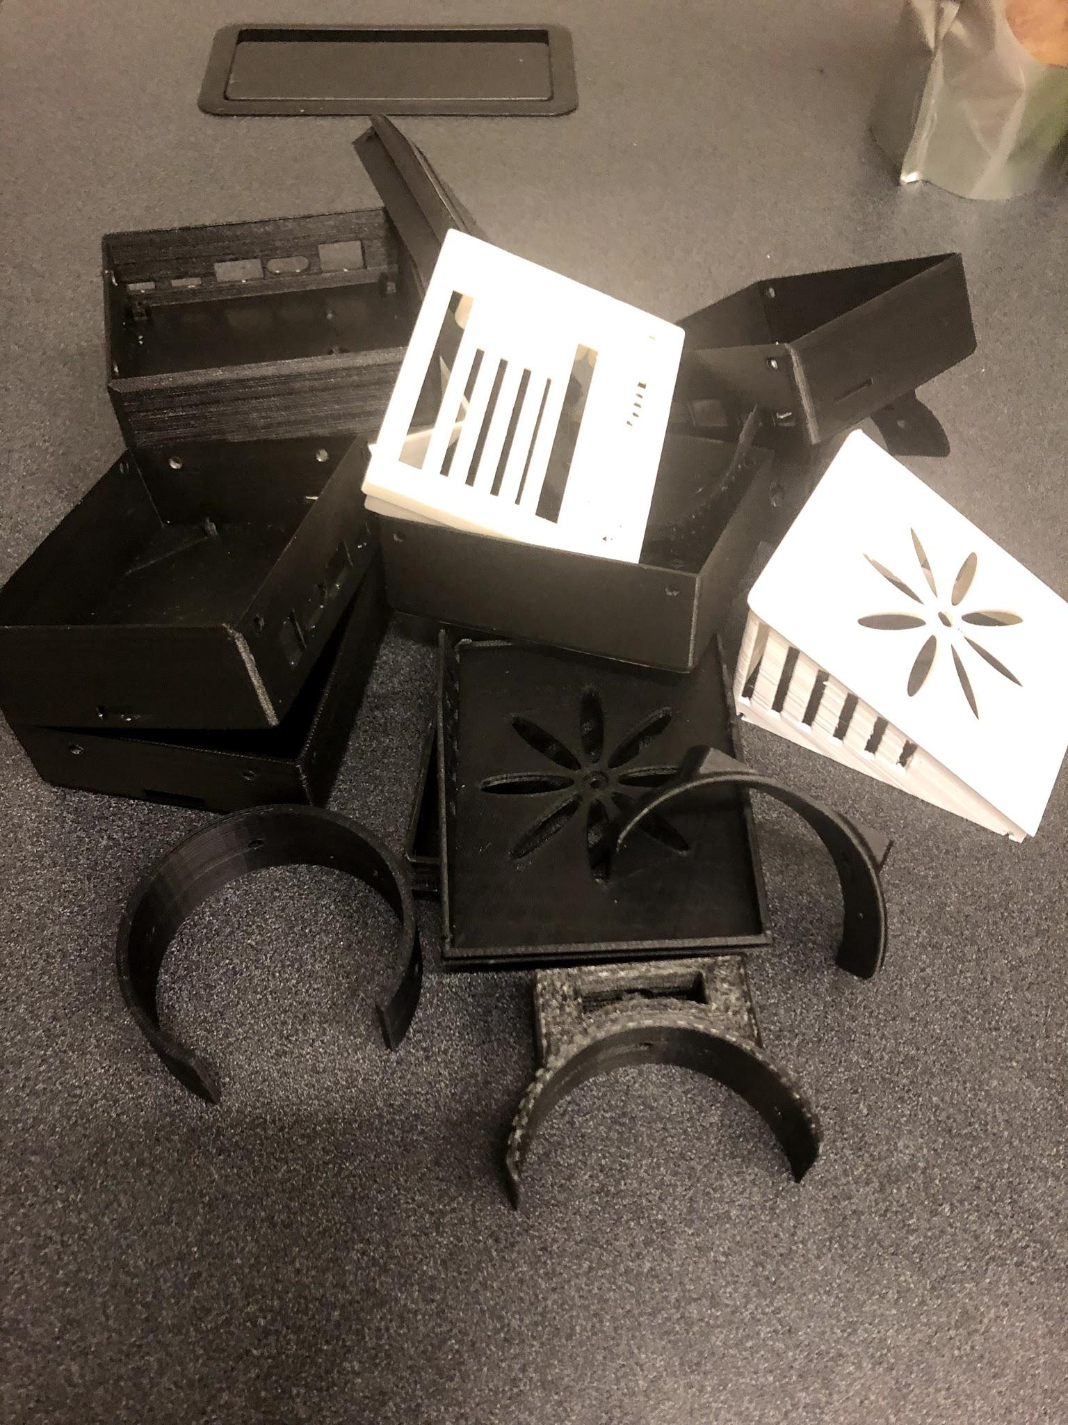
Mechanical Design : : Mounting

Slide 30
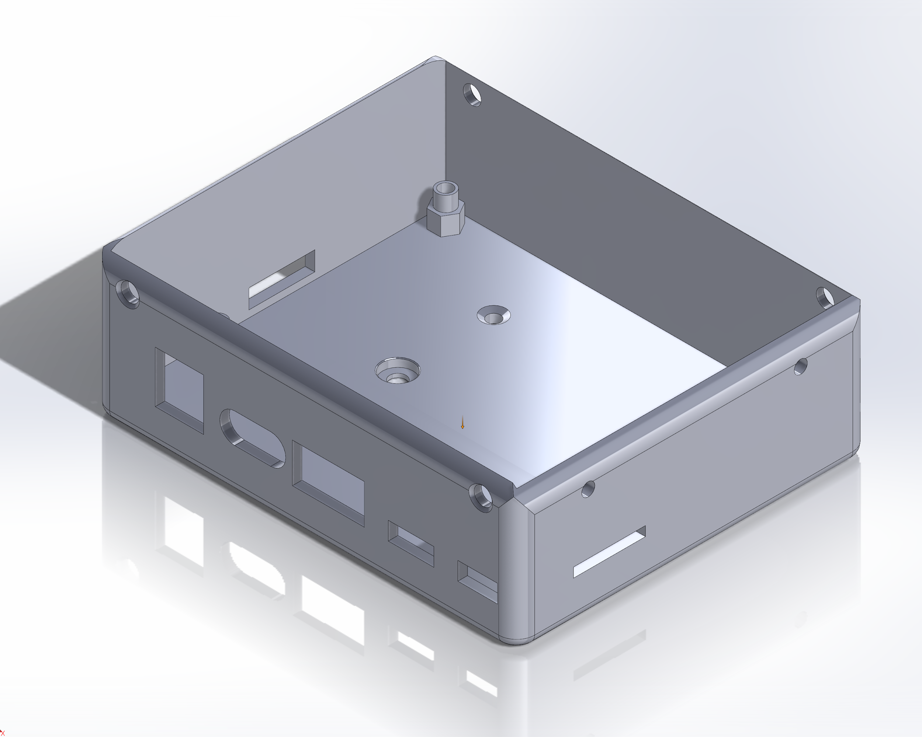
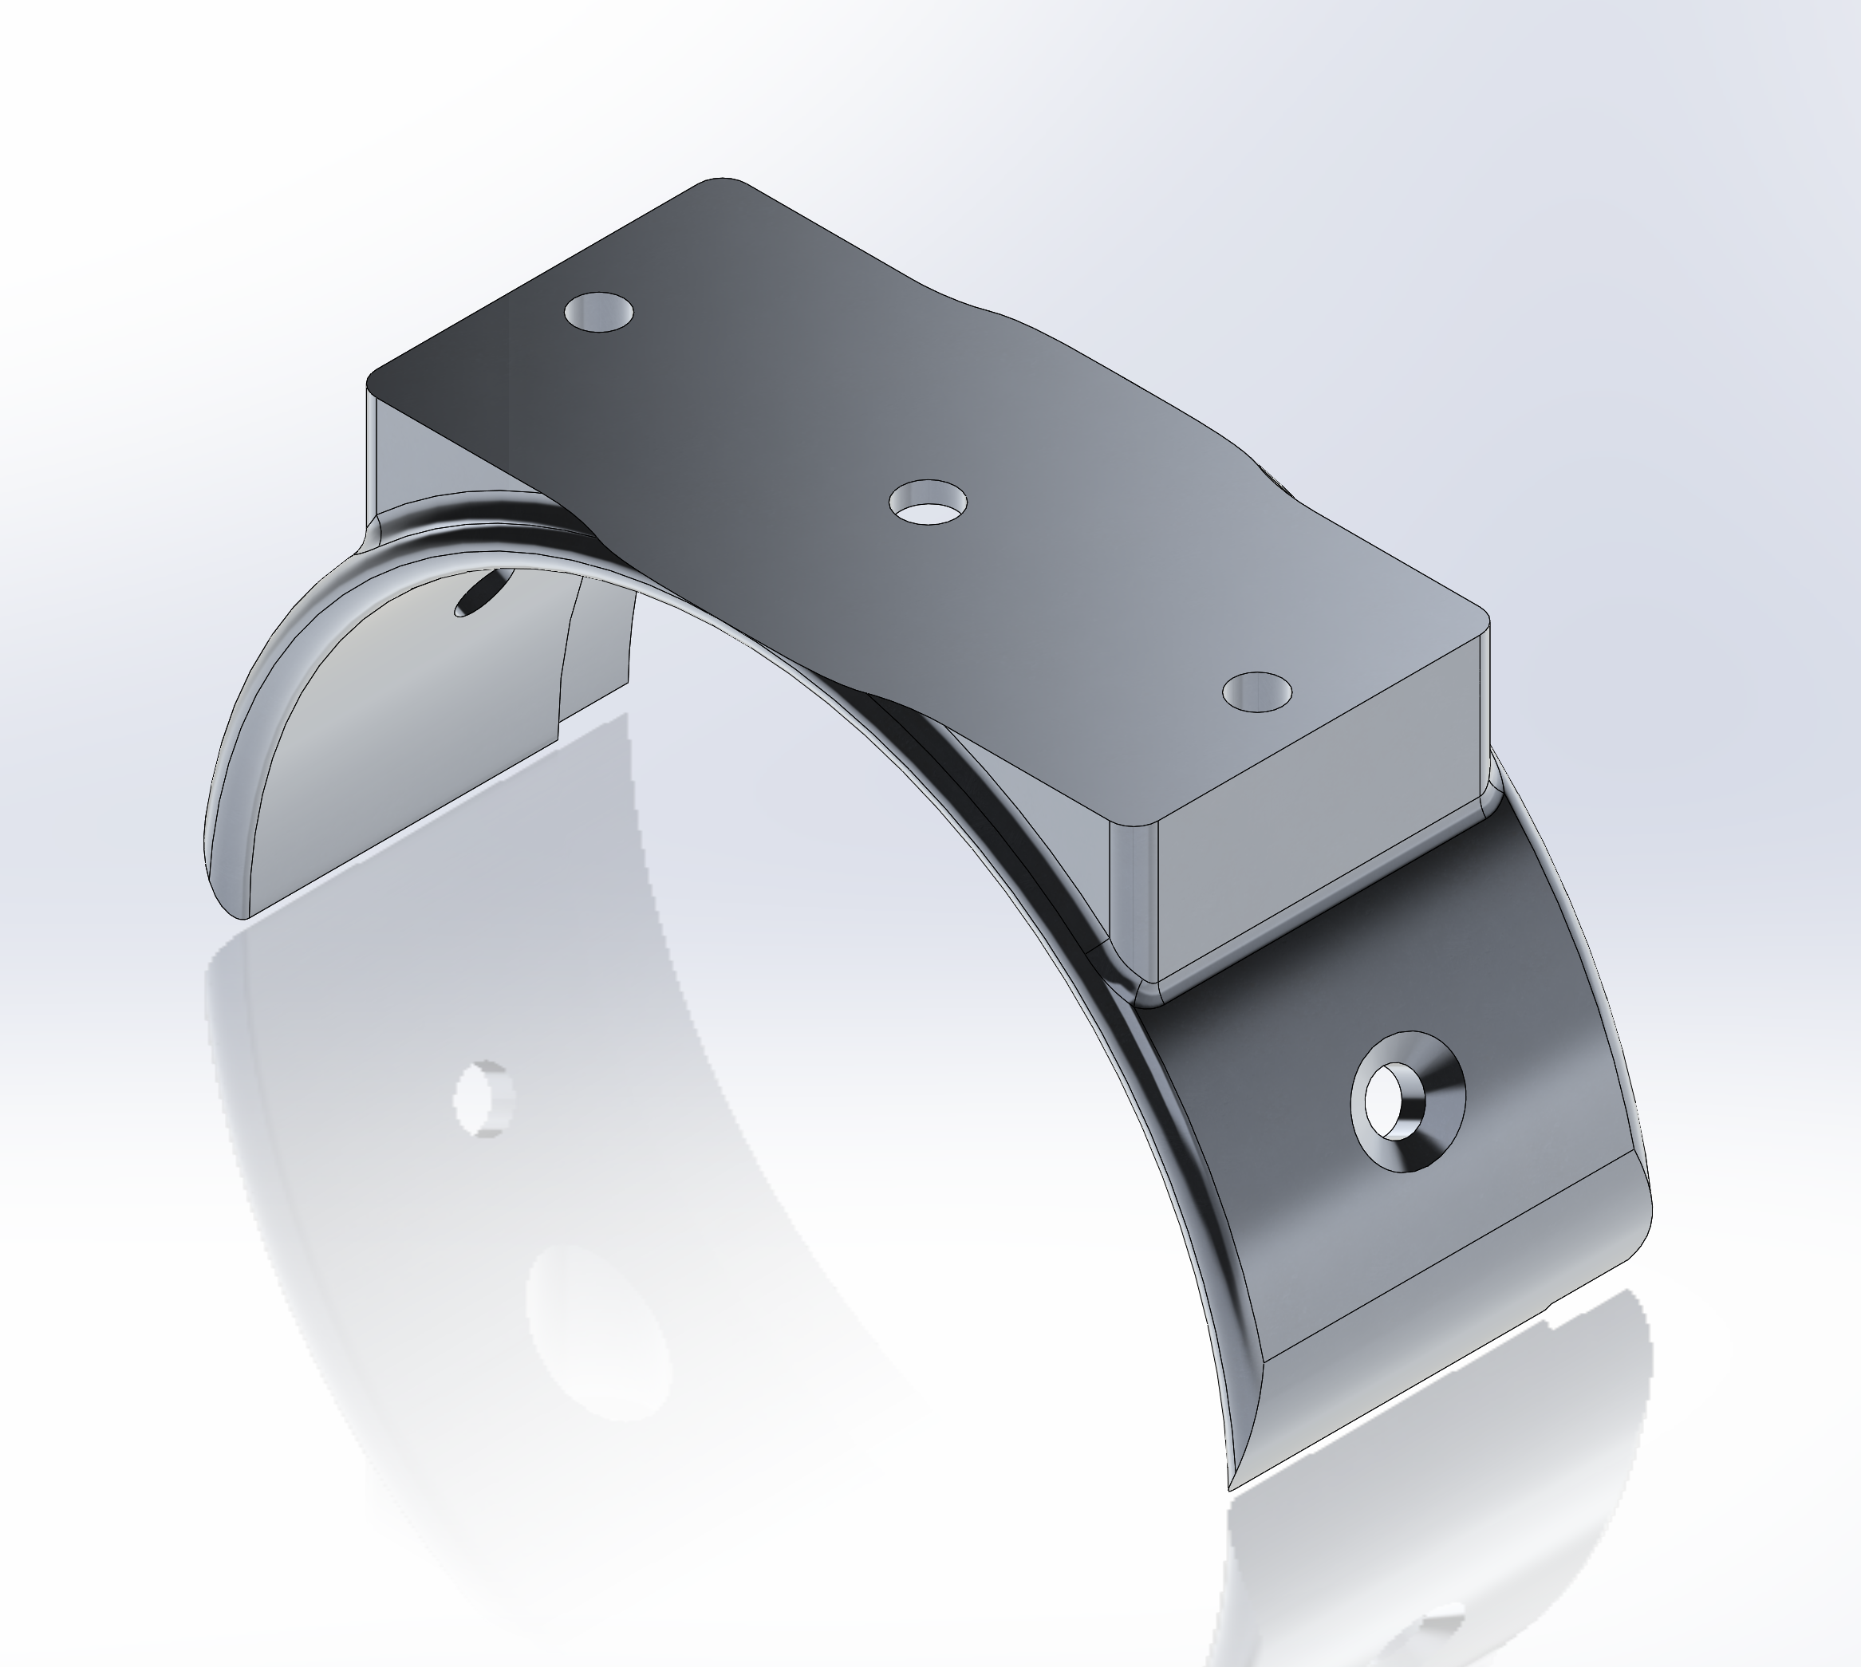
Mechanical Design : : Mounting
Notes:
Screw to Slip ring itself

Slide 31
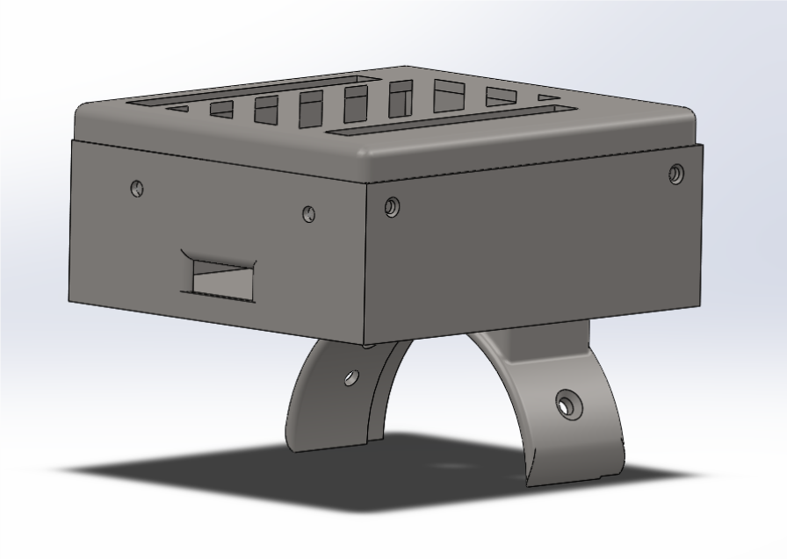
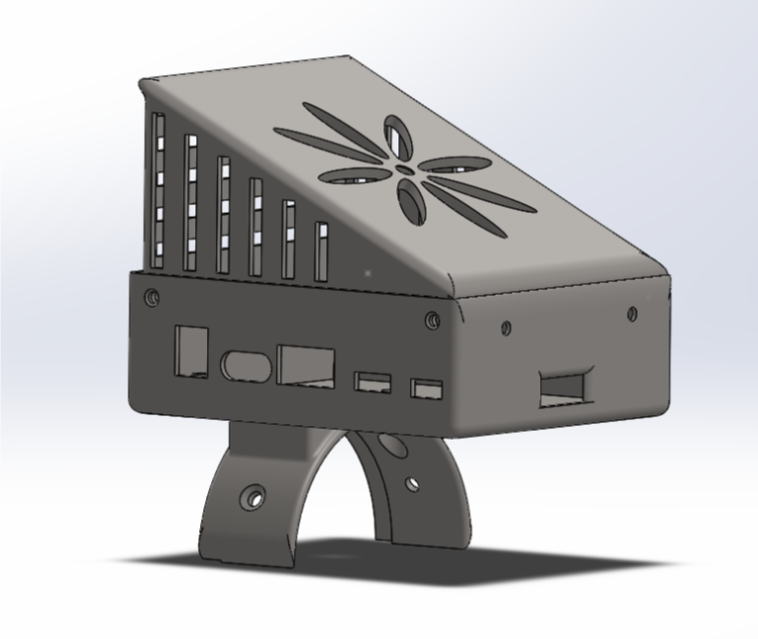
Mechanical Design : : 3D Printing

Slide 32
I have a cool hat !!!
I don’t !:D
Mechanical Design : : 3D Printing

Slide 33
Trade-offs
None :D
But...some insights:
Add a slot on the ring to reduce the resistance with the next joint slip ring.
Use screw to secure the case top with the rigid body.
Make enough holes for cooling purpose.
Mechanical Design : : Trade-offs

Slide 34
Software Design
The magic incantations to make the task happen.

Slide 35
Software Design Requirements
Close to 30 FPS transmission rate
Low latency
Low data loss on video feed
Transmit Color, Depth, Camera Info, Transform matrices.
Post topics on ROS
Software Design : : Requirements

Slide 36
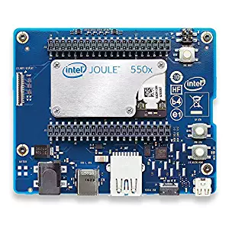
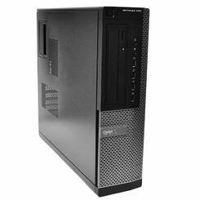
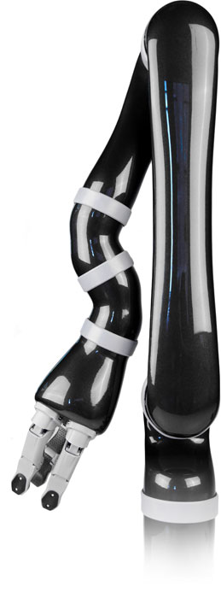
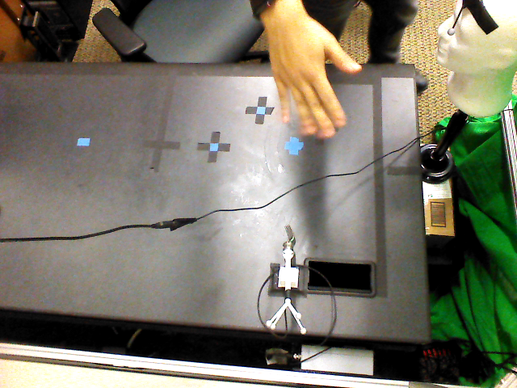
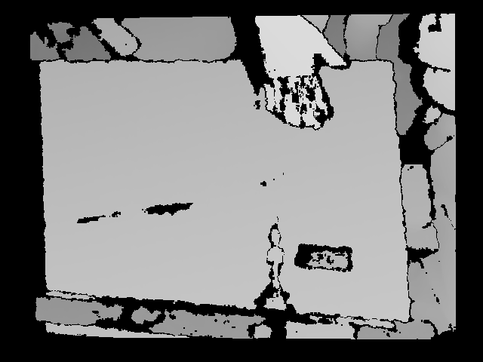
End-effector Computing
Off-board Computing
1
Frame Acquisition
With embedded storage
Without ROS
4
Decode Packets
011010010101..
Parse Binary String to Image Frames
2
Encode Packets
JPEG Compression on Color Frames and Lossless Compression on Depth
Send
via wifi direct
With custom M-JPEG
3
RGB (640x480 px)
D (640x480 px)
Python Custom Compression Layer
Perform
Perception Tasks
5

Slide 37
End-effector Computing
Off-board Computing
1
Frame Acquisition
With ROS Install
camera/color/image_raw
.../image_raw/compressed
4
Decode Packets
011010010101..
RGB (640x480 px)
2
Encode Packets
D (640x480 px)
Parse Binary String to Image Frames
C++ Image Transport layer
Send
via wifi
3
JPEG Compression on Both Color and Depth Frames
Perform
Perception Tasks
5
Software Design : : Overview

Slide 38
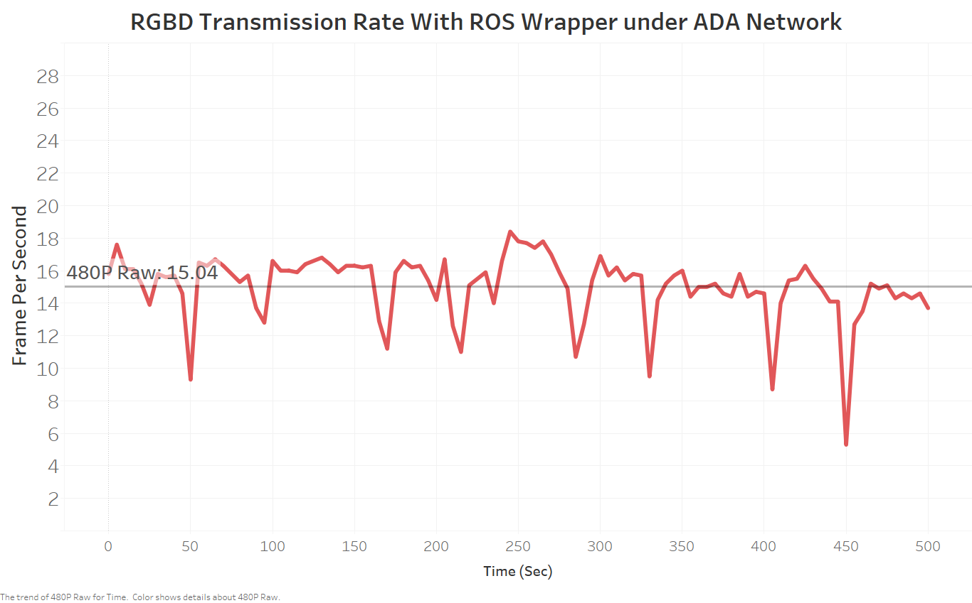
Software Design : : Signal Processing
Notes:
This graph only shows the raw data transmission rate

Slide 39
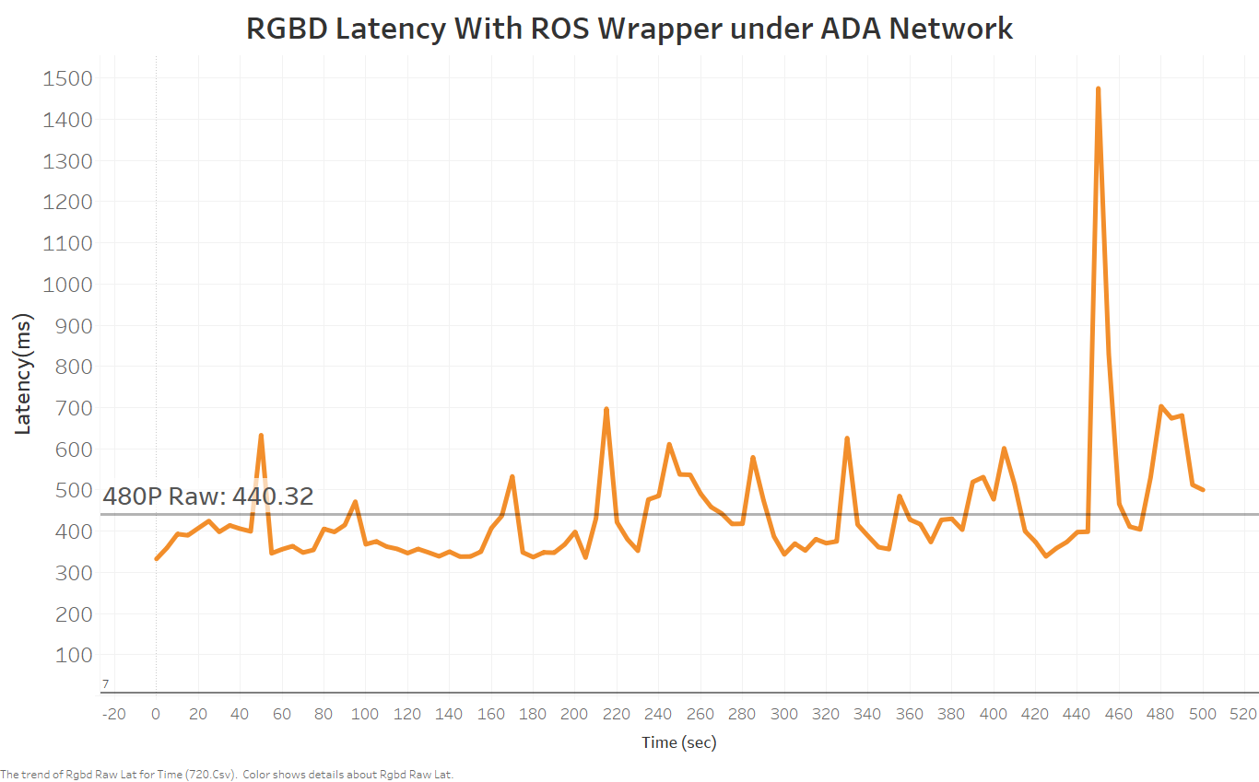
Software Design : : Signal Processing

Slide 40
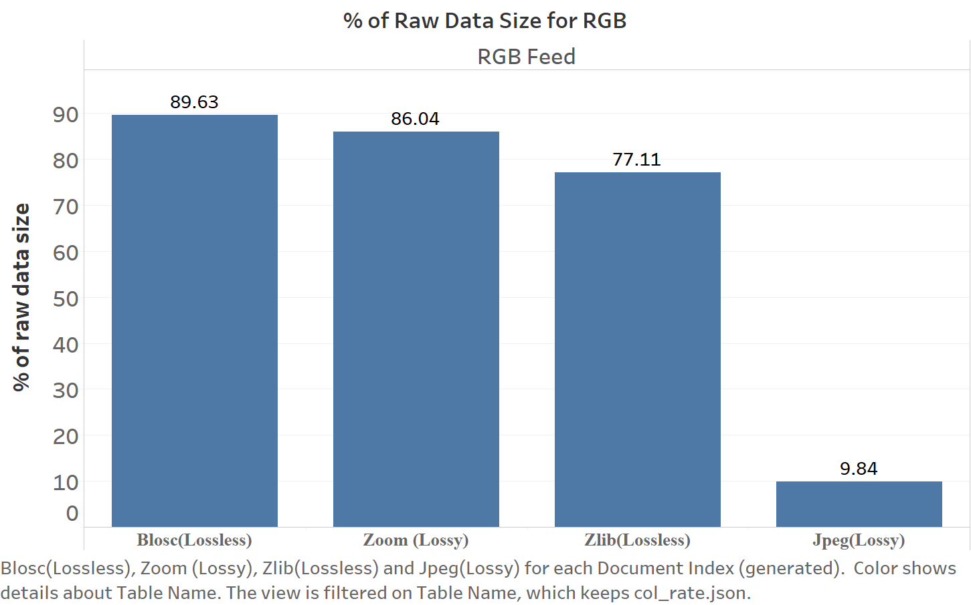
Software Design : : Signal Processing
Notes:
Desdcribe the test: 400 picuters…..appied four compression techniques.

Slide 41
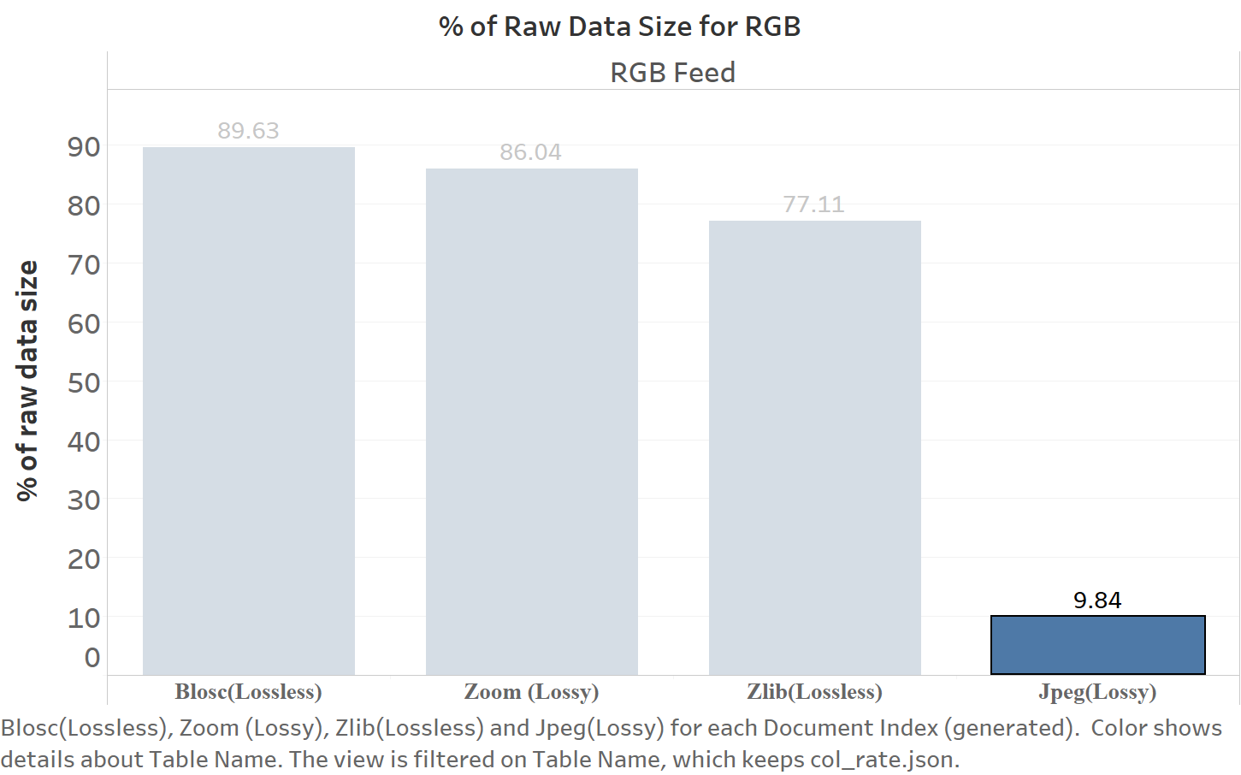
Software Design : : Signal Processing
Notes:
(then highlight best performing method) and articulate why

Slide 42
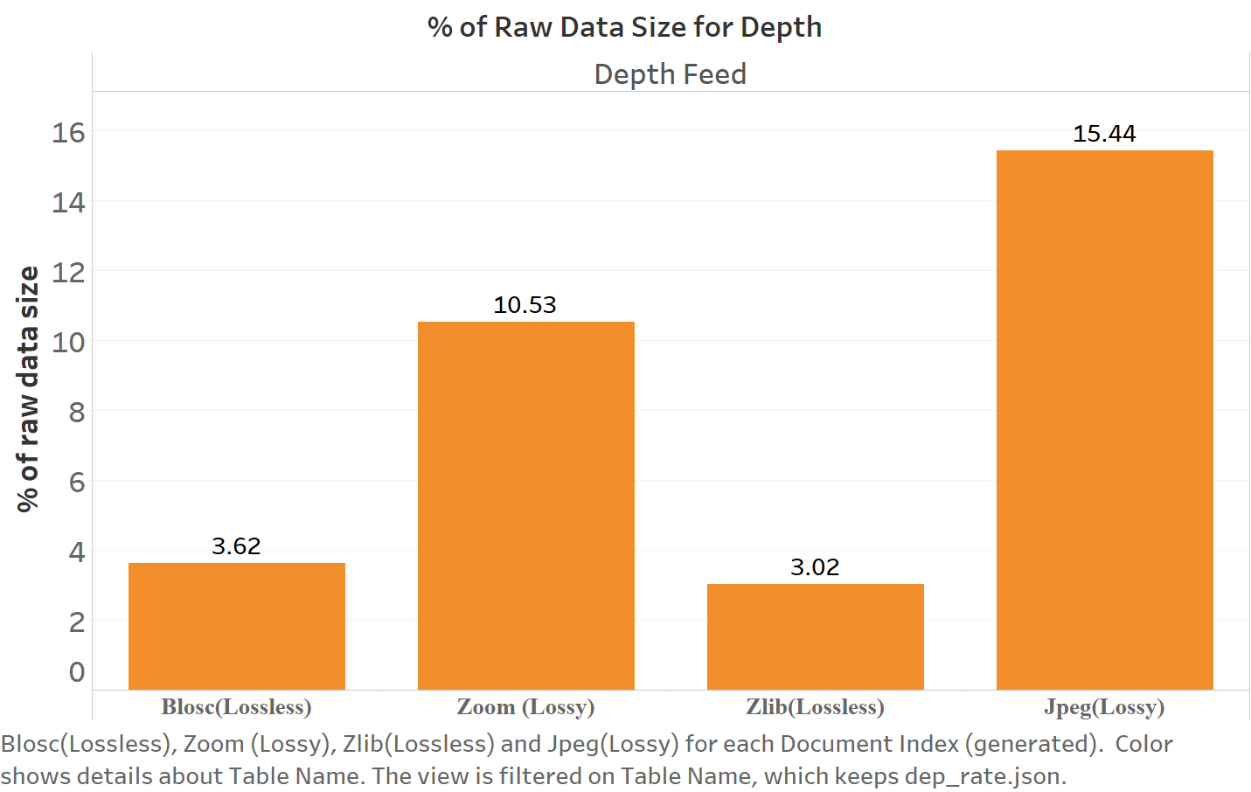
Software Design : : Signal Processing
Notes:
serialize

Slide 43
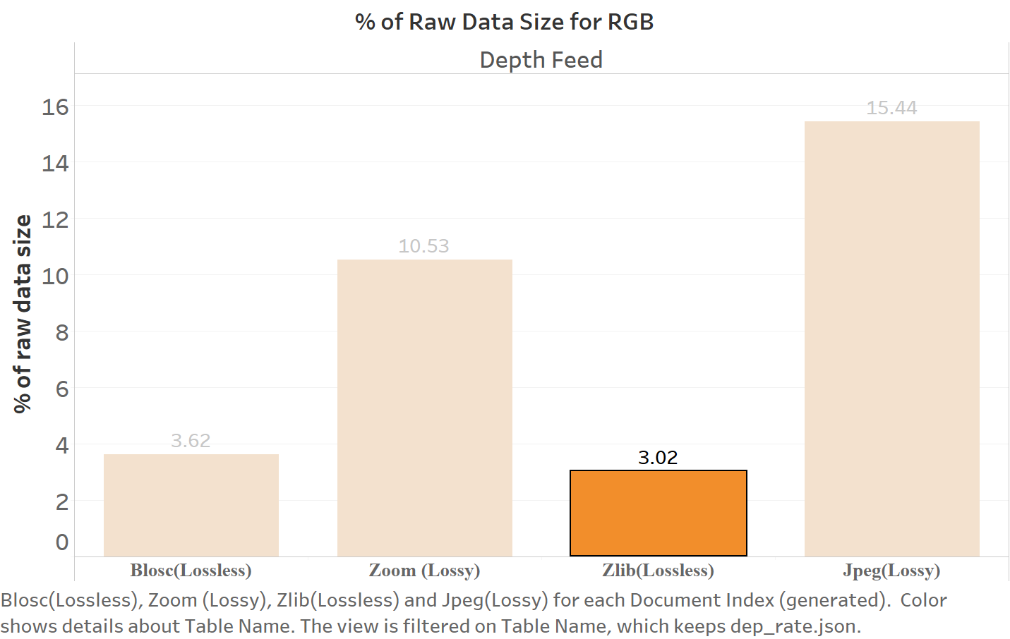
Software Design : : Signal Processing

Slide 44
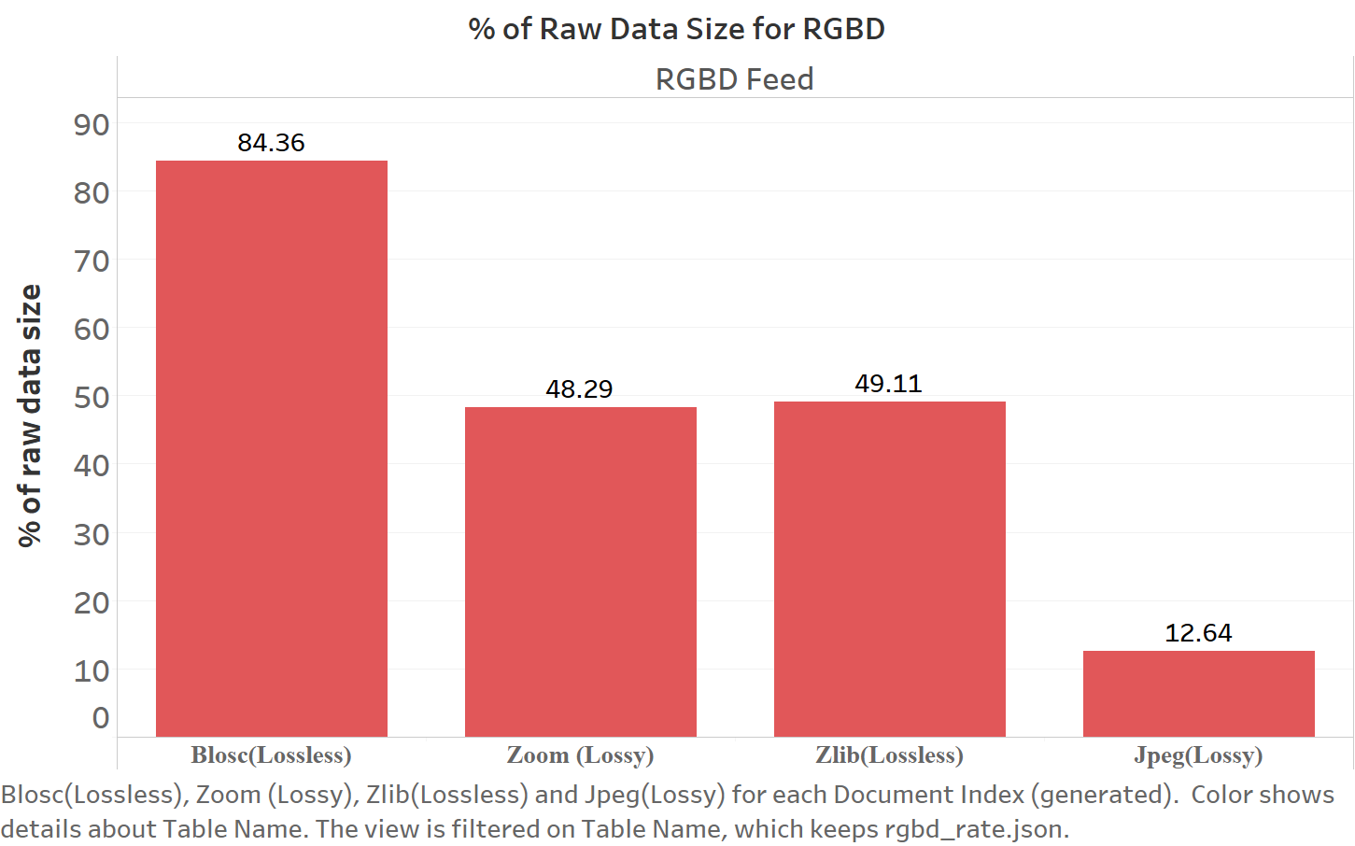
Software Design : : Signal Processing

Slide 45
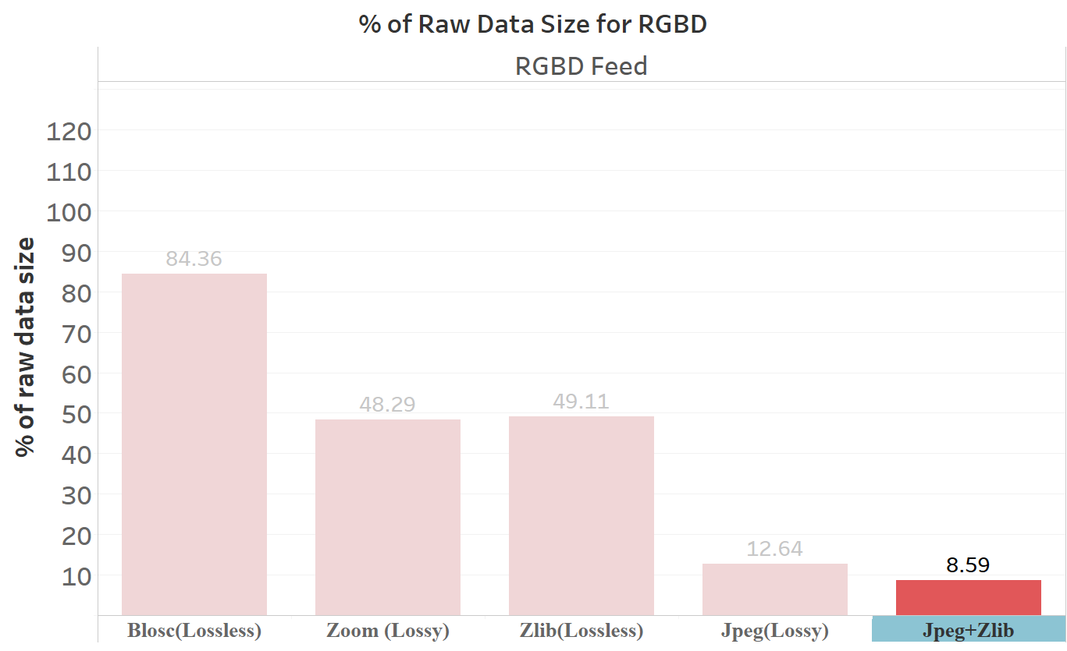
Software Design : : Signal Processing

Slide 46
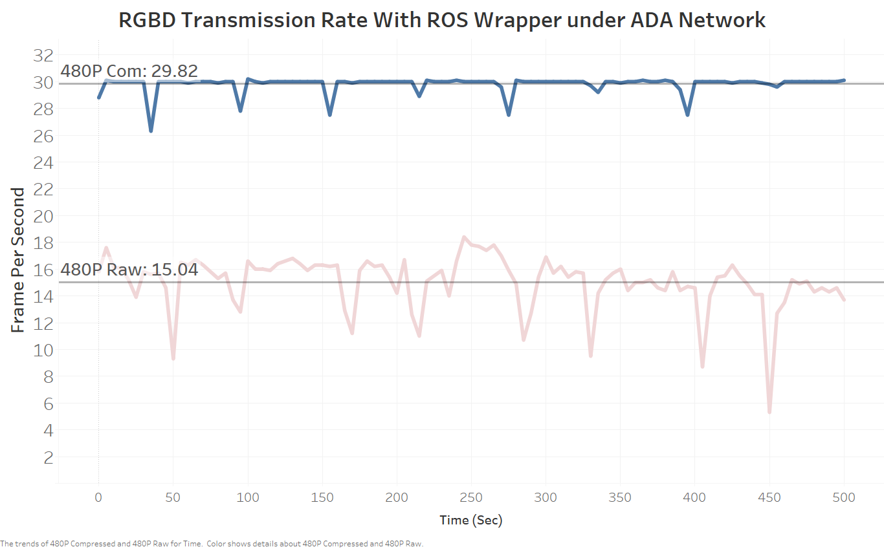
Software Design : : Signal Processing

Slide 47
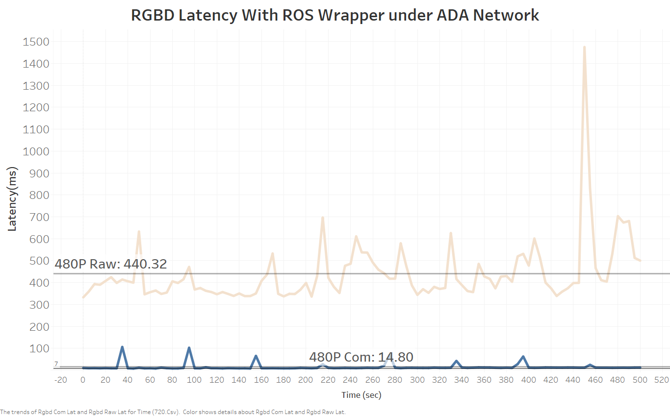
Software Design : : Signal Processing

Slide 48
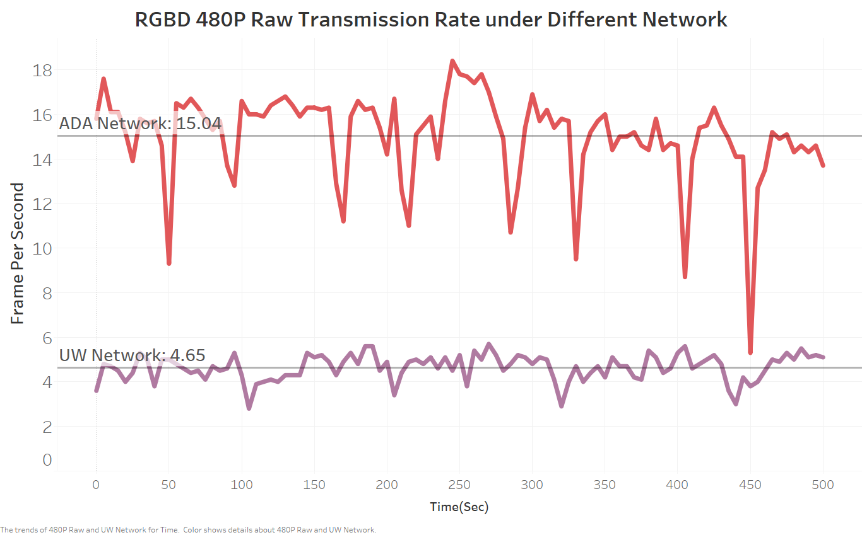
Software Design : : Networking
Notes:
Show plot which compares performance on different networks.
Perhaps also include using the wifi direct approach.

Slide 49
Software Design - Networking
Show plot which compares performance on different networks.
Allude to how the network bridge approach matters and how we can still optimize this a bit.
Software Design : : Networking
Notes:
Wifi - direct vs

Slide 50
Software Design - Networking
ASK ROSARIO: we can probably get a screen shot of the networks in the area and show how the overlapping frequency bands affects performance.
Software Design : : Networking

Slide 51
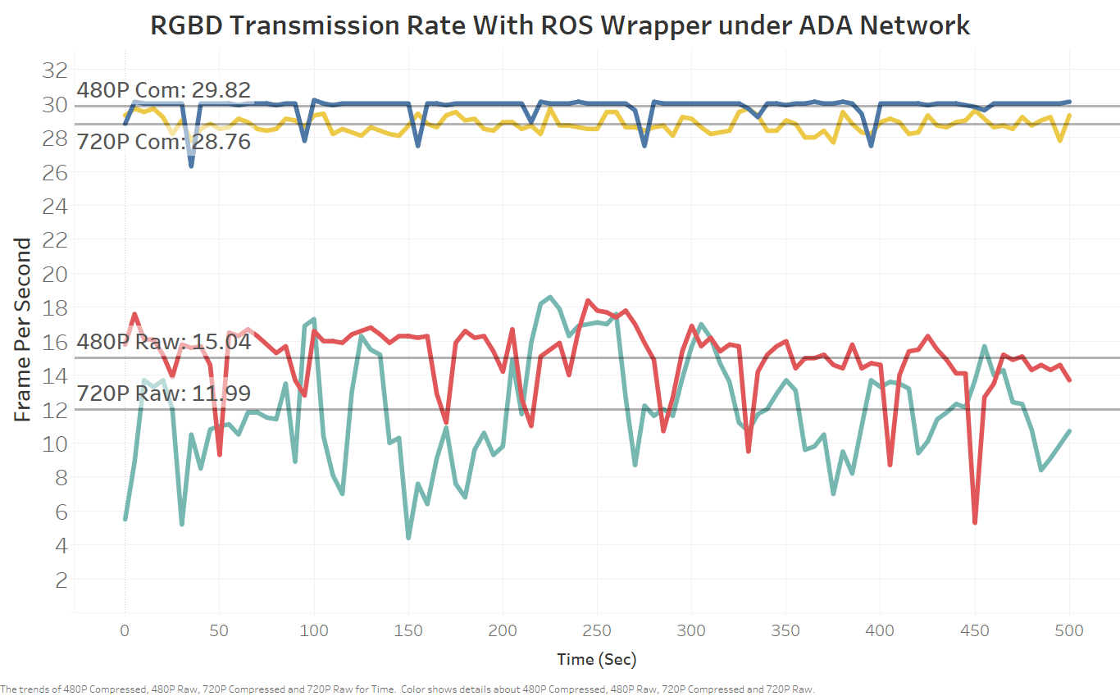
Software Design : : Trade-offs
Notes:
Trade-offs

Slide 52
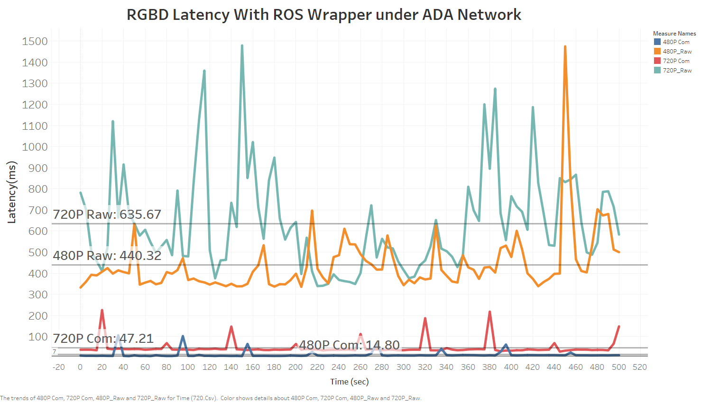
Software Design : : Trade-offs

Slide 53
Trade-offs.
Data Size vs. Transmission Rate
Latency vs. compression method.
Data Loss vs Transmission Rate
Software Design : : Trade-offs
Notes:
Data size -> rate…
Compression method -> latency

Slide 54
Extensibility
Visual
Software Design : : Extensibility

Slide 55
Extensibility
Visual
Thermal
Software Design : : Extensibility

Slide 56
Haptic
Extensibility
Visual
Thermal
Software Design : : Extensibility

Slide 57
Haptic
Smell????
Extensibility
Visual
Thermal
Software Design : : Extensibility

Slide 58
End-effector Computing
Off-board Computing
1
Frame Acquisition
With ROS Install
camera/color/image_raw
.../image_raw/compressed
4
Decode Packets
011010010101..
RGB (640x480 px)
2
Encode Packets
D (640x480 px)
Parse Binary String to Image Frames
C++ Image Transport layer
Send
via wifi
3
JPEG Compression on Both Color and Depth Frames
Perform
Perception Tasks
5
Software Design : : Extensibility

Slide 59
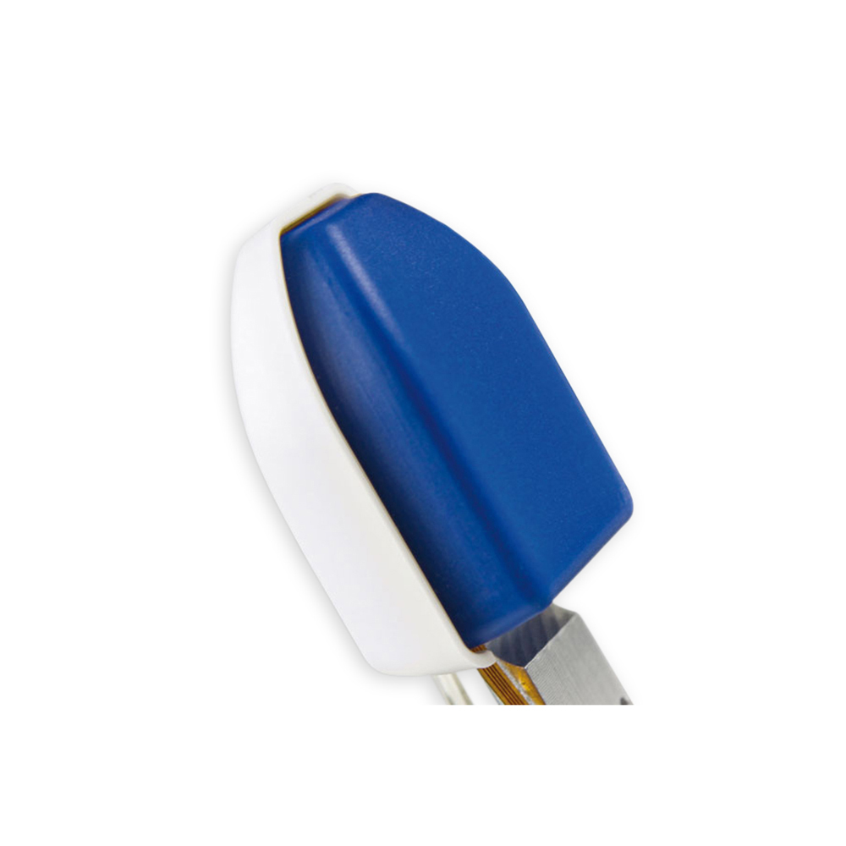
End-effector Computing
Off-board Computing
1
Sensor Data Acquisition
With ROS Install
/sensor/left_raw
/sensor/left_raw/compressed
4
Decode Packets
2
Encode Packets
Some decoding methods
Send
via wifi
Compression layer
3
Encoding methods for the sensor
Perform
Perception Tasks
5
Software Design : : Extensibility

Slide 60
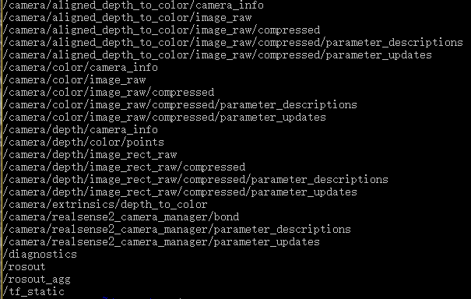
Software Design : : Using the System
Notes:
Maybe tell people what scripts to run and which ros-topics they should look for on the ADA machine if they want to use this in the lab.

Slide 61
Future Work
🙶 Roads?!? Where we're going, we don't need roads! 🙷
- Doc Brown

Slide 62
Future work.
Network optimization (like Wifi-direct ex.)
Network optimization like scanning frequency bands in location and tweaking so there are fewer overlaps.
Additional compression methods
Compress Point cloud.
With Intraframe compression techniques, like H-264.
Future Work : : REV1 Optimizations

Slide 63
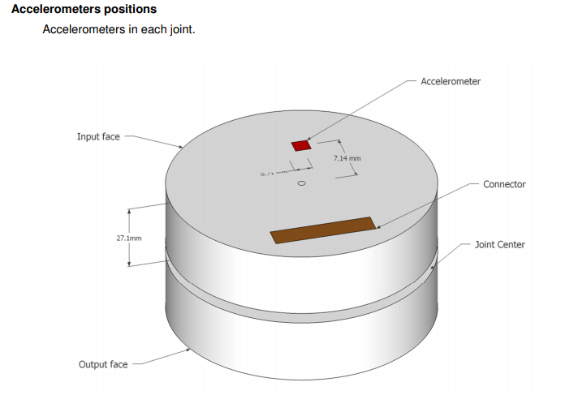
Future work.
0.) Cleaning up the Github Repo to be available to the lab.
Doing more application-specific onboard computing:
On Intel Joule
On Movidius
Object detection, onboard SLAM (Using IMU in J6), etc.
Integrating battery to make the sensor nodes portable
Future Work : : REV2

Slide 64



Notes:
Point cloud video

Slide 65
Thanks! Questions?

Slide 66
Questions we got:
Mechanical vibration reduction?
Other possible specialized hardware for doing video compression

Slide 67
Followup
If time, please investigate alternative approaches. One such approach would involve POV transceivers for drones. Find out what our system affords beyond them.
EX: http://fpv3dcam.com/products-fpv3dcam/the-blackbird2-3d-fpv-camera.html
One additional point to keep in mind is that our system is extensible - meaning it can easily be modified to accommodate many different sensor modalities.
Everything is made of simple off-the-shelf components and could easily be replicated by other researchers. Pick your favorite sensor, get a general purpose computing platform like the Joule, download our open-source repositories, (if Kinova Arm, follow our simple steps for getting power), and download our open-source 3D files to 3D print the parts. Some assembly required.

Slide 68
Communication Protocol
End-effector Computing
Off-board Computing
1
Frame Acquisition
camera/color/image_raw
.../image_raw/compressed
2
Encode Packets
4
Decode Packets
C++ Image Transport layer
011010010101..
JPEG Compression on Both Color and Depth Frames
RGB (640x480 px)
D (640x480 px)
Parse Binary String to Image Frames
Send
via wifi
3
JPEG Compression on Color Frames and Lossless Compression on Depth
.../color_compressed
.../deoth_compressed
Perform
Perception Tasks
Python Custom Compression Layer
5

Slide 69


C++ ROS Wrapper Diagram
Frame Acquisition
Update ROS-node
Send
via wifi
Encode Packets
Decode Packets
Method 1 : ((JPEG?))
RGB (640x480 px)
D (640x480 px)
Method 2 : ((SOMETHING?))
Perform
Perception Tasks

Slide 70
C++ ROS Wrapper Diagram
Frame Acquisition
Update raw data on ROS-node
RGB (640x480 px)
D (640x480 px)
Encode Packets
Decode Packets
Compressed Image Transport. (Compression layer, which compress raw image to JPEG format)
Perform Perception Tasks

Slide 71

Python Wrapper Diagram
ROS
Directlt post on ROS: Methods 1: lossy JPEG compress RGB and lossless compress Depth
Method2 ENcode RGB and Depth together as a custom MJPEG stream
Intel Joule + RealSense
Grab the frames
Receiver decode the ROS topics and use them to do perception tasks
Transmit via WIFI

Slide 72
Guidelines for making a presentation:
Care about your audience. At each slide, think about whether people have the prerequisite knowledge to understand what you are telling them. If not, teach them first in slides that come before hand. Build ideas up from the ground.
Tell an overarching story. And tell mini-stories in subsections.
Organize your presentation logically. Use outline slides occasionally to help them understand what they’re looking at and how it fits into the overall presentation.
Do not crowd slides. Instead, split the slide up into many. Each idea or point should get its own slide.
Do not put useless information on slides. Don’t bother with titles on slides like ‘introduction’, for example. Less is more. Make every word on the slide meaningful or lose it.
Give concrete examples whenever possible. Make it easy for people to build a mental picture of whatever you are talking about.

Slide 73
Guidelines for making a presentation:
Use LOTS of images and diagrams. Complement what people are seeing on the slide with your oral explanation.
Use LOTS of videos to wake people up. Tell people what to direct their attention to about the videos and then let them watch.
Highlight operative words. Use accent colors to draw people’s attention even more.
Cite important things [1] like this.
Yes, aesthetics matter.
Use https://thenounproject.com/ for nice symbols (or emojis to be hip).
[1] Important things - www.importanthings.com - Dr. Super Important et. al

Slide 74
Guidelines for presenting a presentation:
Write what you are going to say for each slide in the ‘speaker notes’ section as if you will read off the text verbatim during presentation.
Practice the presentation the day before for an hour or more.
While giving the presentation, don’t depend on the text, but recall what you were going to say based on the queues left in the ‘speaker notes’.
Speak slowly and clearly, and take your time. DO NOT MUMBLE!
Do not rush through slides. After saying something, let there be silence and let the audience look at the slides for a moment before moving on.

Slide 75
MUST HAVE VIDEOS:
Nicely synchronized video-mosaic of side view of robot + RGB feed + D feed.
Synchronized video-mosaic of side view of robot + RGBD pointcloud visualized with high decay time. (I’ll help you make this in lab).

Slide 76


Kinova Joint 6
Second 8 pins
First 8 pins
Plug Positive side
Plug negative side

